Slide 1

FTTx Technologies
Paul Runcy, Senior Director, Sales
ADTRAN

Slide 2
Agenda
Level Set – Today’s HFC Plant
PON – Passive Optical Networks
PON Architectures
RFoG – Radio Frequency over Glass
EPON – Ethernet Passive Optical Networks
DPoE – DOCSIS Provisioning of EPON
GPON – Gigabit Passive Optical Networking

Slide 3
Level set: The existing HFC Plant

Slide 4
Components of the HFC Cable System
Headend
The primary facility of any cable network
Node
Fiber optic receiver that converts light from the optical
distribution system into RF signals
Amplifier
Boosts the RF signal level along the main
coaxial cables
Tap
Passive device located on the feeder line to provide
connection to customer’s drop
Drop cable
Transport RF CATV signals from the tap to the
in-house wiring
Customer Premises
Equipment (CPE)
Electronics used to provide video, audio, telephony,
etc. for the customer
Notes:
4

Slide 5
Traditional Network
Headend / Hub
Outside Plant
Customer Premises
Transmitter
Power
Power
Trunk
DOCSIS CMTS
Coax
VIDEO
Power
Receiver
Distribution / Feeders
Power
Drops
In a traditional cable network the headend collects all signals and delivers services through a trunk cable.
The trunk cable has numerous amplifiers and accompanying power supplies in order to provide service to each distribution, or feeder cable, connected to it.
The distribution cables and line extenders amplify the signal down towards the taps which connect cable drops to the customer premise.
Notes:
Highlight:
1 RPR vs. many
1 fiber vs. many
same headend equipment
same practices

Slide 6
Hybrid Fiber-Coax (HFC) Network
Headend / Hub
Outside Plant
Customer Premises
Transmitter
Node
Distribution /
Feeder
DOCSIS CMTS
VIDEO
Fiber
Coax
Receiver
Trunk
Drops
In an HFC cable network the trunk cable and amplifiers are replaced with fiber optic cables.
At the headend traditional cable services are converted from RF to optical wavelengths, amplified, and sent out a trunk fiber.
Using an optical fiber on the trunk eliminates amplifiers and accompanying power supplies increasing signal quality and network reliability.
Fiber Nodes are used to terminate the trunk fiber and provide RF services to coaxial distribution lines.
Line extenders, RF taps and coax drop cables are used to connect subscribers to the network.
Notes:
Highlight:
1 RPR vs. many
1 fiber vs. many
same headend equipment
same practices

Slide 7
Passive optical networks

Slide 8
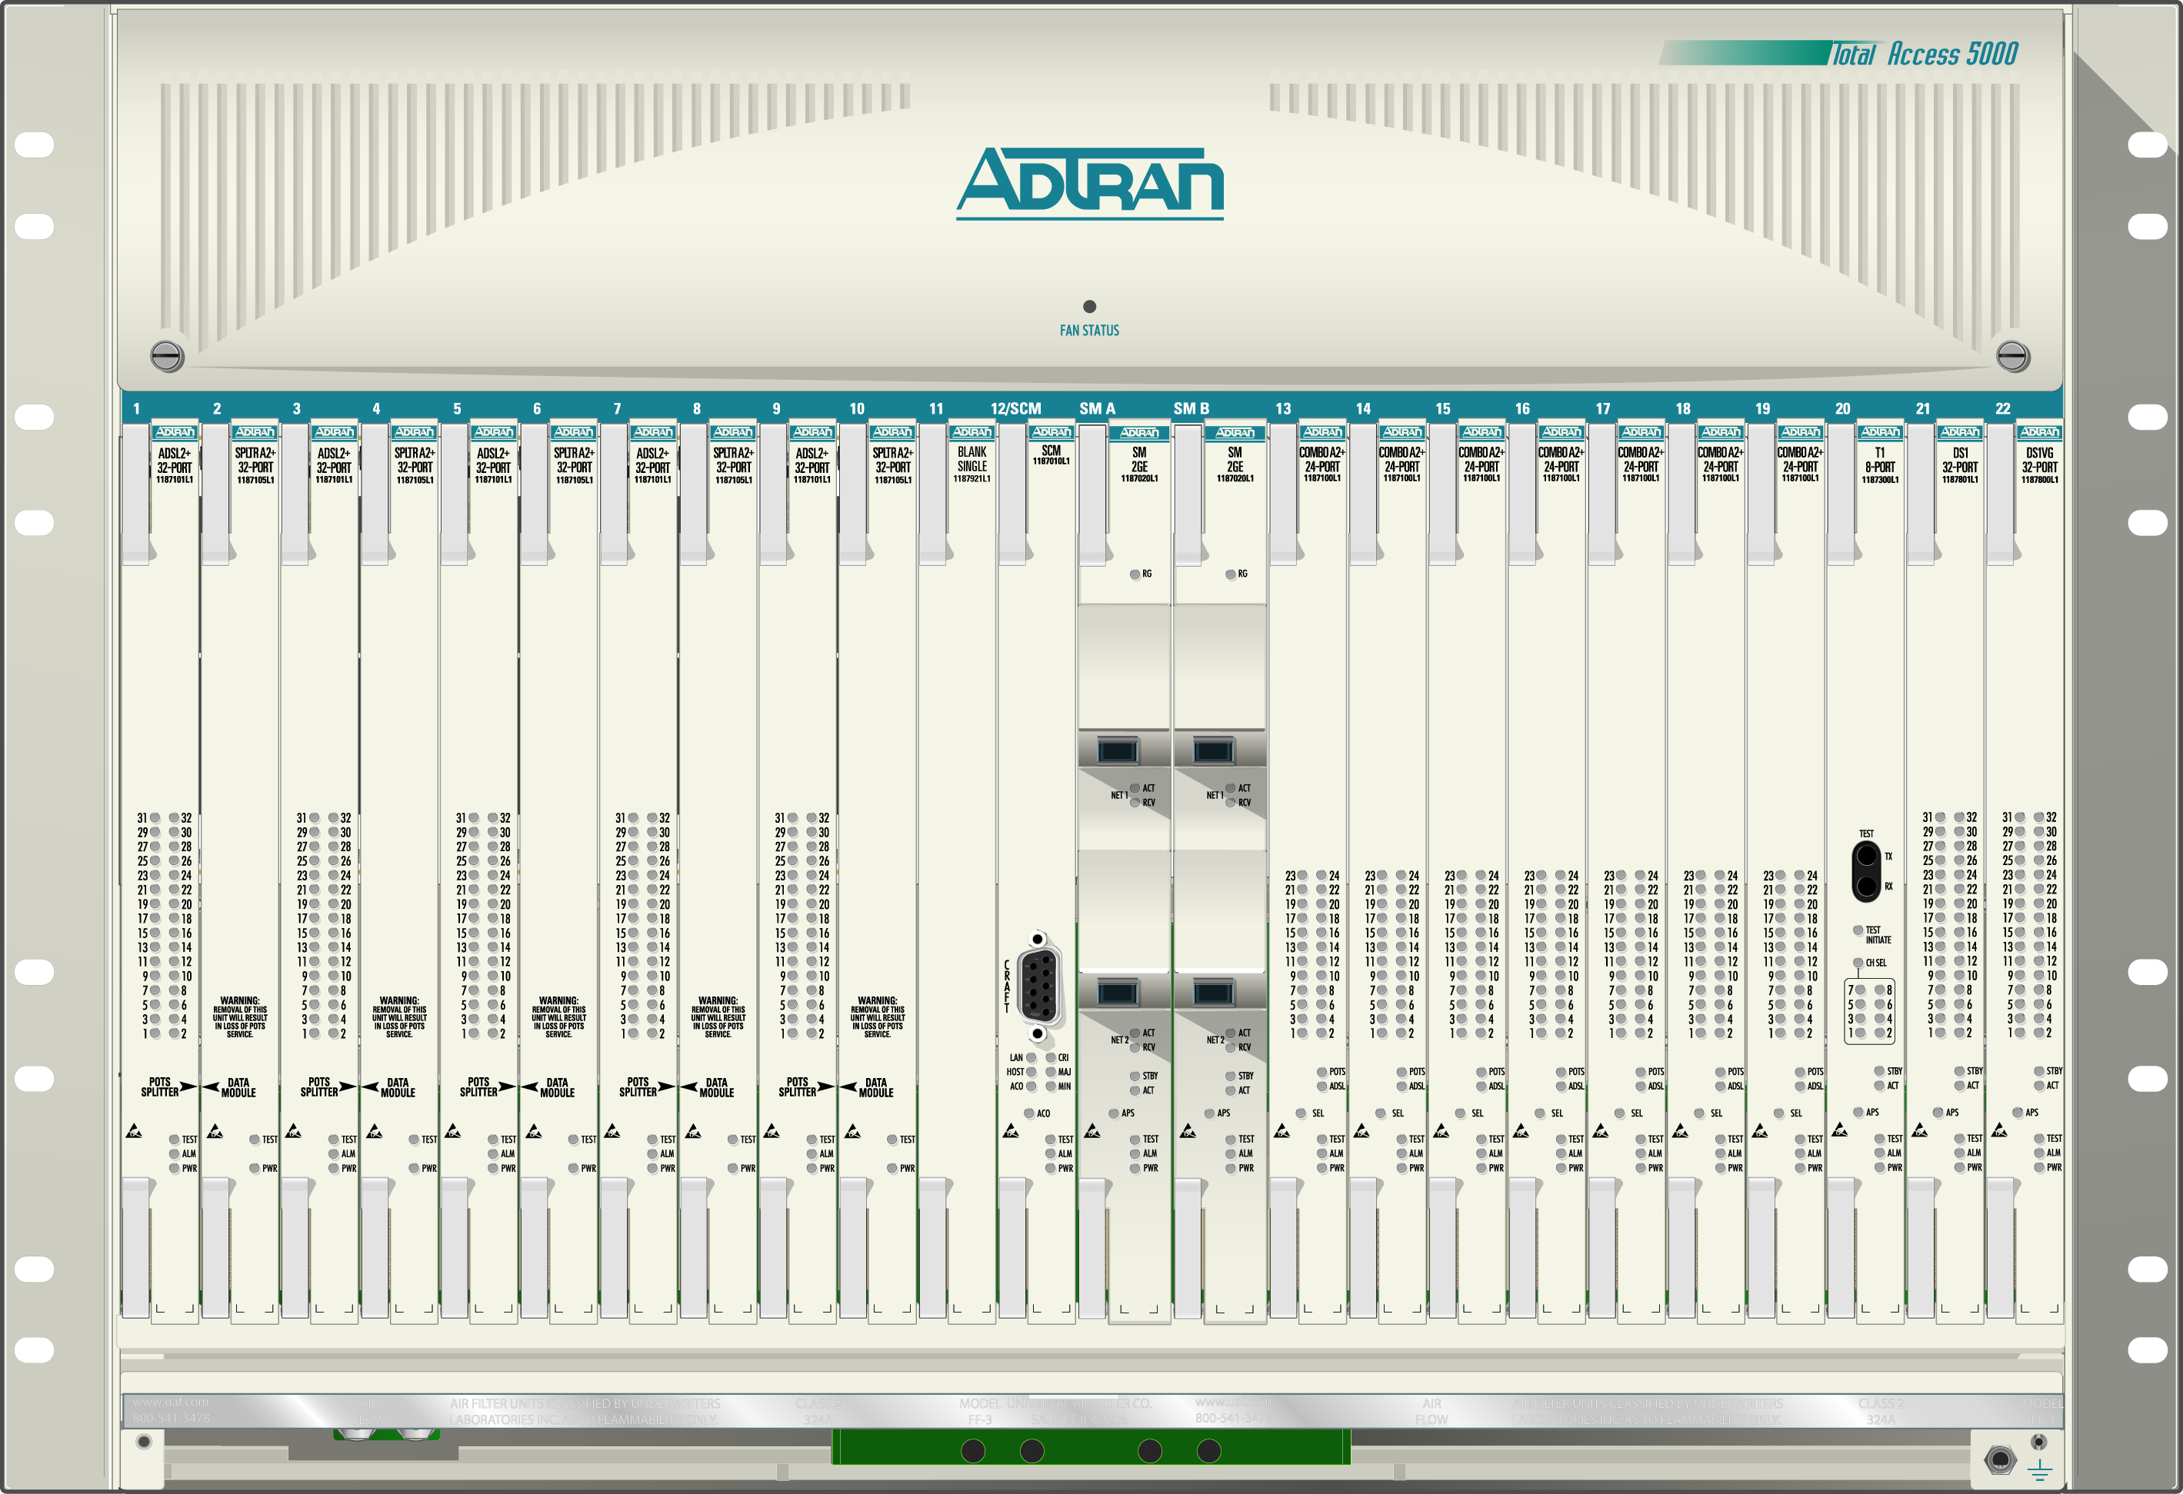

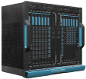
Fiber distribution methods
Port 1
Point-to-Point
Port 2
Usually used with xWDM technology to transport Active Ethernet.
Port 3
*Point-to-Multi-Point
Port 1
Typically referred to as PON and used with EPON, GPON, & RFoG.
Notes:
Architectures that allow fiber to be installed up to the premise can generally be separated into two different delivery methods:
Point to point - In a point-to-point architecture each subscriber has a dedicated path from the source of the transmission to the customer location. Active Ethernet is an example of a point-to-point technology.
Point-to-Multipoint – In a point-to-multipoint architecture subscribers are connected to a common physical plant through the use of taps or splitters. Passive Optical Networking (PON) is an example of a point-to-multipoint technology.

Slide 9
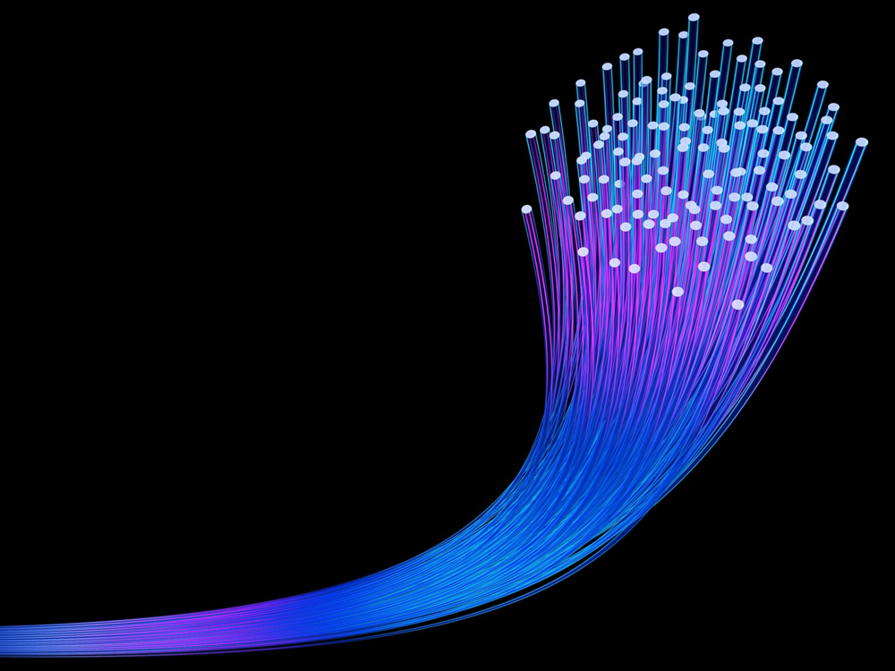
What is a PON?
Passive – no electronics in OSP
Less maintenance, higher reliability
Splitters to allow sharing of network – unpowered, unmanaged
Optical – all fiber
Extremely high bandwidth
Network
Access network technology
Carries voice, video, and
lots of data
Point to multipoint
Notes:
A PON is a passive optical network. There are no optical repeaters or other active devices in a PON, hence the name "passive." PONs are designed for local loop transmission rather than long distance and serve to bring fiber closer to the customer in order to obtain higher speed.
Since PONs are passive, they require less maintenance and provide higher reliability. Splitters are used to share network resources and are unpowered and unmanaged. Fiber provides extremely high bandwidth capabilities to carry voice, video, and data.

Slide 10
Migration from Active to Passive
Traditional - Copper
Active components guide traffic
Network devices require power to transmit data
Processors, memory chips, repeaters, and relays
PON Networks - Fiber
Passive components guide network traffic based on splitting optical wavelengths
Splitters and coupler devices work by passing or restricting light
Notes:
Traditional networks use active components to guide traffic. Devices such as processors, repeaters, and relays all require power to transmit data.
In contrast, passive optical networks use passive components that guide traffic based on splitting optical wavelengths to end points along the way. These passive components, such as splitters and coupler devices, work by passing or restricting light and do not require power to transmit data. Therefore, PONs use less power and cost less to operate.

Slide 11
Passive Optical Network (PON)
Customer Premises
Headend / Hub
Outside Plant
Optical Network Units
“ONUs”
Optical Line Terminal
“OLT”
Fiber
Trunk
Drops
A Passive Optical Network extends the fiber optic cabling all the way to the subscriber premise.
This architecture removes all active amplifiers and power inserters from the cable network.
Optical Network Units (ONUs) are used at the customer premise to convert optical signaling into traditional Ethernet, voice, and video services.
Notes:
Highlight:
1 RPR vs. many
1 fiber vs. many
same headend equipment
same practices

Slide 12
Different Standards, Different PON Technologies
ITU-T G
IEEE 802.3
SCTE
CableLabs®
Point to Multi-Point FTTX Technologies
BPON
622/155 Mbps
EPON
1/1 Gbps
RFoG
(DOCSIS Speeds)
DPoE™
GPON
2.5/1.25 Gbps
10G EPON
10/1 Gbps
10/10 Gbps
XGPON-1
10/1.25 Gbps
NG-EPON
25/50/100 Gbps
XGS-PON
10/10 Gbps
NGPON2
40 Gbps
Notes:
Traditional networks use active components to guide traffic. Devices such as processors, repeaters, and relays all require power to transmit data.
In contrast, passive optical networks use passive components that guide traffic based on splitting optical wavelengths to end points along the way. These passive components, such as splitters and coupler devices, work by passing or restricting light and do not require power to transmit data. Therefore, PONs use less power and cost less to operate.

Slide 13
ITU Standards
The International Telecommunications Union (ITU) is an agency of the United Nations that is focused on telecommunications technologies. It was originally formed in 1865 as a way to standardize telegraph communications. The ITU eventually grew to also include wireless, satellite, maritime , & broadband technologies. www.itu.int
Examples of PON standards/technologies:
G.983 Broadband-capable PON (BPON)
G.984 Gigabit-capable PON (GPON)
G.987 10 Gigabit-capable PON (XG-PON1)
G.9807.1 10 Gigabit-capable Symmetrical PON (XGS-PON)
G.989 40 Gigabit-capable PON (NG-PON2)

Slide 14
IEEE Standards
The Institute of Electrical and Electronics Engineers (IEEE) is a professional association created in 1963. Among other areas of electronic & electrical engineering, the IEEE also focuses on the development of telecommunications standards. www.ieee.org
Examples of PON Standards:
802.3ah Ethernet in the First Mile (EFM) 1G EPON
802.3av 10Gigabit EPON
802.3ca 25/50/100Gigabit EPON task force

Slide 15
SCTE Standards
The Society of Cable and Telecommunications Engineers (SCTE) is a professional association focused on education and development of technologies related to cable telecommunications industry. www.scte.org
Examples of PON Standards:
RFoG SCTE 174-2010

Slide 16
Cable Labs® Standards
Cable Labs® is a not-for-profit innovation and research and development lab founded in 1988 by American cable operators. System operators from around the world are eligible to be members. Cable Labs® was formed by the cable industry to build the foundational technology that now connects the modern world through research, development and innovation.
www.cablelabs.com
Examples of PON Standards:
DPoE™

Slide 17
PON DS/US Wavelengths
*
*The original 1310nm optics were +/- 50 nm. Newer, narrower 1310nm optics are now generally available

Slide 18
PON Parameters
Optical budget
Depends on class of optics
  Class A – 20dB
  Class B – 25dB GPON / PR20 EPON 24 dB
  Class B+ - 28dB GPON / PR30 EPON 29 dB
  Class C – 30dB GPON / PR40 EPON 33 dB
Most vendors have implemented Class B+ / PR30
Logical Reach
~20 Kilometers with 32 splits
Maximum distance between OLT and ONU
Split Ratio
1:128 estimated 4-6km
1:64 estimated 15-18 km
1:32 estimated 20-25 km
Depends on implementation
Typical Downstream (1490nm) Budget
OLT Launch Power = +3dBm
ONU Receive Sensitivity = 0dBm to -25dBm
Link Budget = 28dB
Typical Upstream (1310nm) Budget
ONU Launch Power = +1dBm
OLT Receive Sensitivity = -8dBm to -29dBm
Link Budget = 30dB*
Typical Downstream (1577nm) Budget
OLT Launch Power = +2dBm
ONU Receive Sensitivity = 0dBm to -28dBm
Link Budget = 30dB
Typical Upstream (1270nm) Budget
ONU Launch Power = +4dBm
OLT Receive Sensitivity = -8dBm to -28dBm
Link Budget = 32dB*
*Loss in fiber is higher at 1270/1310nm as compared to 1490/1577nm

Slide 19
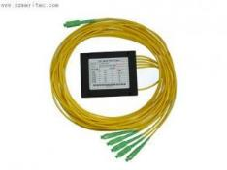
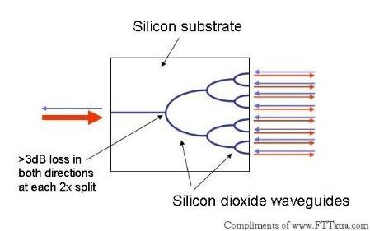
The Optical Splitter
Planar Splitter

Slide 20
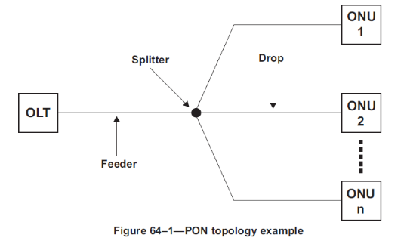
Network Losses
Fiber Loss + Splice/Connector Loss + Splitter Loss ≤ 28dB

Slide 21
Typical Assumptions
Fiber Loss
Connector Loss
Splice Loss
Splitter Loss
@ 1310nm: 0.34dB/km or 0.00010363 dB/ft
@ 1490nm: 0.25db/km or 0.00007622 dB/ft
SC/APC: 0.25dB
0.05dB
1 x 2: 3.5dB
1 x 4 7.5dB
1 x 8 10.7dB
1 x 16 13.8dB
1 x 32 17.5dB
1 x 64 21.5dB

Slide 22

Centralized Split
PON OLT
-
ONT 1
Drop Fiber (1km)
Feeder
Fiber (19 km)
17.5 dB
Loss
PON
ONT 1
1 x 32
Distribution
Thru
Fibers
ONT 32
Splitter
ONT 32
Loss Type | Connector | Splice | Fiber | Splitter
Loss | 4 @ .25dB Each | 10 @ 0.05dB Each | 20km @ 0.34/km | 1 x 32
Total | 1.0dB | 0.5dB | 6.8dB | 17.5dB | 25.8dB

Slide 23
Cascaded Splitters
Drop Fiber
ONT 1
1 x 4
-
-
3
4
ONT 2
Drop Fiber
Splitter
ONT 3
ONT 4
1 x 4
Drop Fiber
Splitter
ONT 5
ONT 6
Feeder
ONT 7
Fiber
3.5 dB
1 x 2
splitter
7.5 dB
ONT 8
1 x 4
ONT 9
Splitter
ONT 10
7.5 dB
ONT 11
1 x 4
ONT 12
Splitter
ONT 13
ONT 14
Loss Type | Connector | Splice | Fiber | Splitter
Loss | 6 @ .25dB Each | 12 @ 0.05dB Each | 20km @ 0.34/km | 1x2, 1x4, 1x4
Total | 1.5dB | 0.60dB | 6.8dB | 3.5dB+7.5dB+7.5dB | 27.4dB

Slide 24
PON Architectures

Slide 25
Integrated PON (I-PON)
Challenge | Practical Considerations
Distance | Worst case (20 to 30 (km), less with larger split ratio)
Subscriber Density & Capacity | Worst case (32 ONUs per port, less at larger distances)
Trunk Fiber Conservation | Worst case
Headend / HUB Space & Power | Worst case
Management & Networking | Best case (uniform, centralized)

Slide 26
I-PON + Repeater
Challenge | Practical Considerations
Distance | Middle case (Long reach DBA penalties are troublesome)
Subscriber Density & Capacity | Best case (128 ONUs per port)
Trunk Fiber Conservation | Best case
Headend / HUB Space & Power | Worst case
Management & Networking | Middle case (better if repeater is manageable)

Slide 27
Remote PON (R-PON)
Challenge | Practical Considerations
Distance | Best case
Subscriber Density & Capacity | Best case (128 ONUs per port)
Trunk Fiber Conservation | Best case
Headend / HUB Space & Power | Middle case (additional Ethernet aggregation ports required)
Management & Networking | Worst case (many R-OLTs to network and manage)

Slide 28
SDN PON
(S-PON)
Challenge | Practical Considerations
Distance | Best case
Subscriber Density & Capacity | Best case (128 ONUs per port)
Trunk Fiber Conservation | Best case
Headend / HUB Space & Power | Best case (assuming shared spine/leaf switches)
Management & Networking | Unclear (can be best case if done well or worst case if not) At Comcast, this is more than the vDPoE Controller, it’s how they plan to do everything. Our solution MUST make it as simple and valuable as possible.

Slide 29
RFoG: Radio Frequency over glass

Slide 30
RFoG Network Benefits & Considerations
Fiber is run all the way to the premise thus creating a “future proof” outside plant.
Improved signal quality allows better utilization and higher data rates.
Ingress and RF issues are largely isolated to customer premise.
Technical expertise of headend & premise installations and technology is leveraged (no re-training).
Optical Beat Interference may impact upstream signals in an RFoG deployment.
RFoG
“Micro Node”
Transmitter
DOCSIS CMTS
Fiber
VIDEO
Trunk
Drops
Receiver
Notes:
Highlight:
1 RPR vs. many
1 fiber vs. many
same headend equipment
same practices

Slide 31
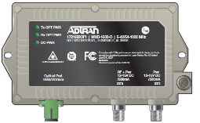
DOCSIS RFoG Network
MTA
STB
20 km
RFoG Micro Node
DOCSIS CMTS
λ = 1550 nm
VIDEO
Fiber
λ = 1610 nm
Optical Splitter
1 x 32
CM
Coax
Notes:
Highlight:
1 RPR vs. many
1 fiber vs. many
same headend equipment
same practices

Slide 32

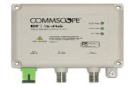








RFoG Home Architecture & CPE
Spare ports available for other devices
Inside Coax Wiring
Ethernet, USB,
or wireless
Regular telephone wiring
RFoG
Fiber
MicroNode Coax Brick Powering Not Shown
Customer Premise Equipment (CPE) with MicroNodes
Single fiber supports both forward and return path
MicroNode provides optical to electrical conversion
5-42 / 54-1002MHz support
SC/APC connector towards fiber network
“F” connector to 75 ohm coax cable towards premise
Dedicated or inserted powering options

Slide 33
OBI: Optical Beat Interference
Upstream interference caused when:
Two or more RFoG micro nodes transmit simultaneously
At very close or same wavelengths
Why would micro nodes transmit simultaneously?
STB transmitting while CM transmitting.
CM transmitting on one upstream while another CM transmitting on another US.

Slide 34
OBI Example
CM 1
t₀: f=f₁
t₂: OBI
Coax
RFoG Micro Node 1
DOCSIS CMTS
t₁: λ = 1610 nm
VIDEO
Fiber
λ = 1610 nm
Optical Splitter
1 x 32
CM 2
t₀: f=f₂
Coax
RFoG Micro Node 2
Notes:
Highlight:
1 RPR vs. many
1 fiber vs. many
same headend equipment
same practices

Slide 35
Optical Beat Interference
Impacts of OBI include:
Return signal noise floor elevation
Service degradation on impacted CMTS receiver
Code word errors on CMTS upstream
CM 1
t₀: f=f₁
t₂: OBI
Coax
RFoG Micro Node 1
DOCSIS CMTS
t₁: λ = 1610 nm
VIDEO
Fiber
λ = 1610 nm
Statistically chances of OBI will increase when:
Multiple upstreams are used (DOCSIS 3.0)
Number of active customers increase
Increase of upstream data being transmitted
Optical Splitter
1 x 32
CM 2
t₀: f=f₂
Coax
RFoG Micro Node 2

Slide 36
Addressing OBI – Active Splitter
Active splitters have been developed to prevent OBI by isolating the optical domain for each subscriber:
PROs:
By isolating optical domain, this can eliminate OBI.
Subtending splitters can scale to support over 1000 ONUs
Does not require site visit to change CPE for existing RFoG networks
DOCSIS CMTS
ACTIVE SPLITTER
CONs:
Requires powered facilities in the field
Requires 19” rack space in the field
First subscriber costs are extremely high for new deployments or less-dense applications
Active devices create additional points of failure in the network
May not be compatible with existing passive splitter deployments
VIDEO

Slide 37
Addressing OBI – Selectable Upstream
R-ONUs are available with upstream wavelength conditioning that eliminate OBI:
PROs:
OBI is eliminated by not allowing R-ONUs to share the same wavelength.
Lower initial cost compared to active splitter solutions
Utilizes existing passive infrastructure
CM 1
Optical Splitter
1 x 32
Coax
DOCSIS CMTS
CM 2
VIDEO
Fiber
CONs:
Available wavelength selections are currently limited thus limiting the number of R-ONUs per splitter (currently 16)
Requires manual setting for each R-ONU to be effective
Requires detailed record keeping for all customer settings
Misconfiguration compromises OBI prevention
Coax
CM 3
Coax

Slide 38
Addressing OBI – Wavelength Randomization
MicroNodes implement wavelength randomization to combat OBI:
PROs:
OBI is mitigated by randomly adjusting upstream wavelengths.
Lower initial cost compared to active splitter solutions
Utilizes existing passive infrastructure
No extensive record keeping
No manual configurations required
CM 1
Optical Splitter
1 x 32
Coax
DOCSIS CMTS
CM 2
VIDEO
Fiber
Coax
CONs:
Although mitigated extensively, OBI is not entirely eliminated
CM 3
Coax

Slide 39
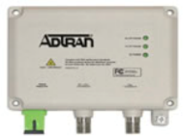
Standard Micro Nodes
  Downstream
λ: 1550 nm
Rx: -6 to 0 dBm
  Downstream
Freq.: 54 to 1002 MHz
Tx: 17 dBmV
CM
  Upstream
λ: 1610 nm
Tx: 3 dBm
  Upstream
Freq.: 5 to 42 MHz

Slide 40
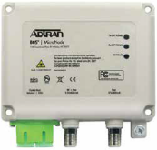
Micro Nodes: with a PON bypass filter
PON Pass-Through
TV
Downstream λ
RFoG: 1550 nm
1G EPON: 1490 nm
10G EPON: 1577nm
STB
10G
EPON
Upstream λ
RFoG: 1610 nm
1G EPON: 1310 nm
10G EPON: 1270nm

Slide 41
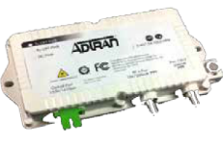

OBI Mitigation Micro Nodes MND-1602-O
OBI Mitigating
Mitigates OBI by:
Using narrow spectrum laser to reduce interference probability; narrower than standard R-ONU
Randomizing wavelength via autonomous dynamic wavelength assignment (Lambda Motion™ Wavelength Randomization)

Slide 42
Ethernet
Passive optical networking

Slide 43
What is EPON?
Ideal for high bandwidth commercial and residential installations
MAC Layer Supports a 100 km service area, typical optical budgets support a 20 km service area with 1:32 split ratio.
10/1 Gbps Down x 10/1 Gbps Up symmetrical service to each PON
Gigabit Ethernet PON or Ethernet PON (GePON/EPON) is a Passive Optical Network access technology defined by IEEE 802.3ah and IEE 802.3av.
Uses separate wavelengths:
1G 1490 nm downstream & 1310 nm upstream.
10G 1577 nm downstream & 1270 nm upstream*
Notes:
A PON is a passive optical network. There are no optical repeaters or other active devices in a PON, hence the name "passive." PONs are designed for local loop transmission rather than long distance and serve to bring fiber closer to the customer in order to obtain higher speed.
Since PONs are passive, they require less maintenance and provide higher reliability. Splitters are used to share network resources and are unpowered and unmanaged. Fiber provides extremely high bandwidth capabilities to carry voice, video, and data.

Slide 44
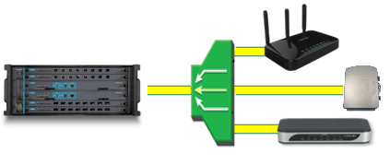
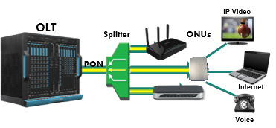
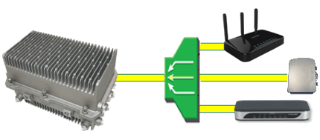
EPON Components
EPON OLT - – An Optical Line Terminal aggregates all subscriber devices in a EPON network.
Passive Splitter – The passive splitter splits/combines numerous subscriber fiber drops into a single fiber run to the OLT. Although splits of up to 1:128 may be achieved, typical EPON deployments use up to a 32-way split serving 32 residences from a single OLT EPON port.
ONU- An EPON ONU is installed either outside or inside the subscribers premise and typically interfaces directly to the inside/premise wiring (coax, Ethernet, telephony).
Configuration of the ONU may occur through the OLT by means of Ethernet Operations Administration & Management (OAM) messages. Once online, the ONU may also receive configuration instructs to its IP address by a provisioning server.
Splitter
ONUs
OLT
PON
Uplink
IPTV
Headend
IP Core
Voice
Switch
Internet
OLT
Splitter
Uplink
PON
ONUs
Notes:
OLT
An EPON system consists of an aggregation device called an optical line terminal (OLT). OLTs can be high dense chassis located in headend or hub locations, temperature hardened chassis in cabinet deployments, or node based solutions located within the outside plant. The OLT connects to the Outside Plant (OSP), or Optical Distribution Network (ODN), through PON interfaces. Connections to the service provider IP network core is accomplished through 1Gbps up to 100Gbps uplink interfaces.
Splitters
Splitters passively divide optical energy from an input port into any number of output ports. Although splits of up to 1:128 may be achieved, typical EPON deployments use up to a 32-way split serving 32 residences from a single OLT EPON port. These splitters can be located anywhere, at the serving office or closer to the served area, reducing fiber costs. Individual fibers run from each residence back to the splitter.
ONU
In an EPON network, subscriber’s voice, video, and data devices are connected to the PON via the ONU.
The ONU associates IP Voice/Video/Data traffic by Logical Link Identifier (LLID) and combines/splits the signal with analog and/or digital video to and from the OLT.
An EPON ONU is installed either outside or inside the subscribers premise and typically interfaces directly to the inside/premise wiring (coax, Ethernet, telephony).
Configuration of the ONU may occur through the OLT by means of Ethernet Operations Administration & Management (OAM) messages. Once online, the ONU may also receive configuration instructs to its IP address by a provisioning server.

Slide 45
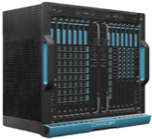


10G-EPON Network Details
DS: 1577nm
US: 1270nm
Up to 20km*
Receiver Sensitivity
OLT: Approximately -28dBm
ONU: Approximately -28.5dBm
These values vary based on optics. Check vendor documentation for details
Transmit Power
Measured launch power at OLT +2 to +5dBm
Due to a burst mode transmitter, power level at the ONT may be difficult to measure and requires an inline power meter. Launch power at ONT may be up to +9dBm
10Gig EPON Optics
Optics | PR10 | PR20 | PR30 | PR40
Max. Loss | 20dB | 24dB | 29dB | 33dB
1/10Gig Co-existence EPON Optics
Optics | PRX10 | PRX20 | PRX30 | PRX40
Max. Loss | 20dB | 24dB | 29dB | 33dB

Slide 46
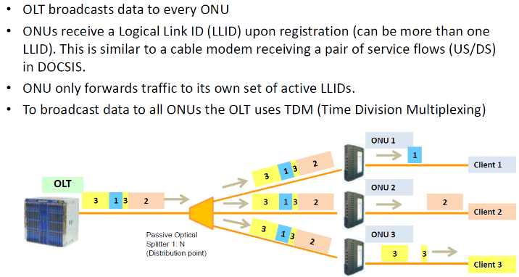

Downstream
Notes:
The OLT learns the ONU MAC address in the discovery process which triggers the creation of a “virtual cable modem”, or “vCM”. The vCM requests an IP address from the DHCP server and is told what configuation file to download and where the tftp server is located. When the configuration file is received the vCM translates the DOCSIS TLVs into DPoE OAM which is sent to the ONU for provisioning. Upon completion of processing the OAM messages, provisioning is completed and IP connectivitiy to the subscriber is established. MTAs for VoIP, RGs for data, or other services at the subscriber premise or embedded in the subscriber equipment can then use the IP connectivity to complete there service provisioning depending on the customer’s acquired services.
The OLT forwards all traffic downstream towards the PON. This would imply that each ONU is subjected to all traffic destined to the entire PON. In order to minimize the amount of traffic processing, and not to mention security concerns, the OLT assigns one or more Logical Link IDentifiers (LLIDs) to an ONU. Early EPON implementations used an LLID per ONU to manage traffic with some vendors also implementing a “broadcast LLID” which was share amoungst multiple ONUs. With newer implementations each ONU can host numerous LLIDs in an effort to better segregate and manage certain traffic types. For example, today an ONU may have an LLID for best effort data, one for VoIP, one for WiFi, and one for multicast traffic.

Slide 47
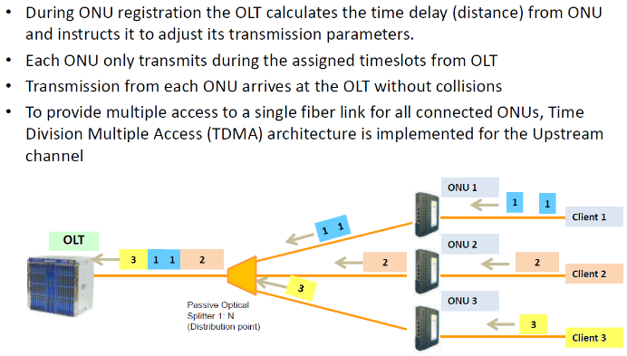
Upstream
Notes:
Immediately after powering up the ONU will look for a downstream signal. If one is available it will listen for a discovery window that will inform the ONU when it is ok to advertise that it is on the PON. Once the discovery window is known the ONU will advertise itself by means of its MAC address. The OLT will validate whether the ONU is permitted on the PON through its admission control and, if allowed, will proceed with further provisioning processes (either EMS, CLI, or DPoE).

Slide 48
EPON Upstream Co-Existence

Slide 49
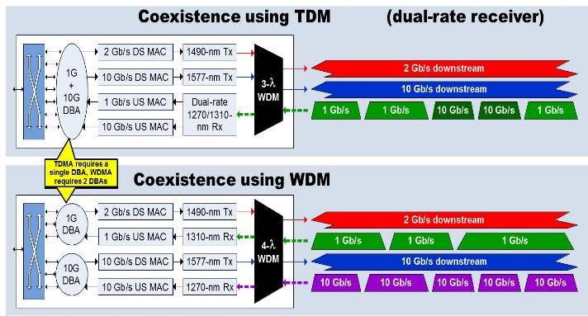
Co-existence Options

Slide 50
10G-EPON Summary
Defined by IEEE 802.3av-2009 10G-EPON
EPON is a point-to-multipoint, Passive Optical Network technology
Optical wavelengths used are 1577nm in the downstream & 1270nm in the upstream
Can coexist with existing IEEE 802.3ah EPON solutions
Native end-to-end Ethernet solution
Supports voice, data, and video (RF overlay or IPTV)
Symmetrical bandwidth per port. (Downstream rate 10Gbps, Upstream rate 10Gbps)
Bandwidth is shared across subscribers on each PON port.
Each PON port typically supports 32 subscribers and a service area of 20km
Can use a proprietary management platform or existing DOCSIS provisioning system

Slide 51
EPON Evolution
2004 802.3ah
2009 802.3av
2011 DPoEv1
2012 DPoEv2
2013 SIEPON
(2019?) NG-EPON
EPON Standard Evolution:
  802.3ah: 1G/1G specification (2004)
  802.3av: 10G/10G specification (2009)
  DPoE v1: DOCSIS Provisioning over EPON (2011)
  DPoE v2: DOCSIS Provisioning over EPON (2012)
  SIEPON: Service Interoperability in Ethernet Passive Networks (2013)
  NG-EPON: IEEE already working on next generation 802.3 EPON for 25/50/100Gbps speeds

Slide 52
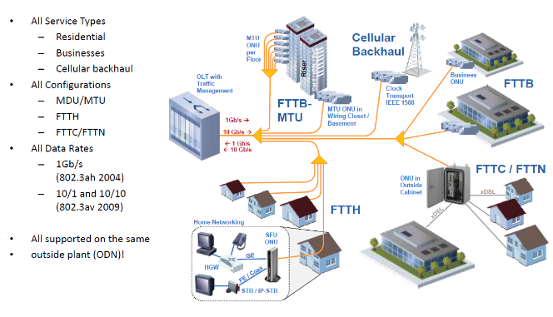
EPON as Universal Fiber Access Architecture

Slide 53
Docsis Provisioning of EPON (DPoE)

Slide 54
What is DOCSIS Provisioning of EPON
DOCSIS
EPON
DPoE

Slide 55
DPoE Specifications
CableLabs qualified the first DPoE v1.0 hardware systems in June 2013. The process of qualifying meant that submitted equipment must adhere to the specifications list in the following areas:
DPoE Architecture Specification (ARCH)
DPoE IP Network Element Specification (IPNE)
DPoE Metro Ethernet Forum Specification (MEF)
DPoE MAC & Upper Layer Protocols (MULPI)
DPoE OAM Extensions Specification (OAM)
DPoE Operations Support System Interface specification (OSSI)
DPoE Physical Layer Specification (PHY)
DPoE Security & Certificate Specification (SEC)

Slide 56
Benefits of DPoE
There are millions of DOCSIS cable modems (CMs) that continued to be deployed and managed worldwide
Cable Operators want to leverage their investment and expertise by using the same Operations and Support Systems (OSS) with any access technologies.
CableLabs certification process
Multi-vendor interoperability between OLTs & ONUs
Multigigabit high speed data services
Metro Ethernet commercial service capabilities
Notes:
DPoE makes use of the well established DOCSIS provisioning tools deployed by worldwide Cable operators. This allows service providers to deploy services across an all fiber EPON network in much the same manner as their exisiting DOCSIS network. Not only are there significant cost savings in the re-use of the existing OSS/BSS integration but there are substantial operational benefits since technical staff will not have to adapt to this new technology and may leverage much of their existing experience in the new access architecture.

Slide 57
Comparison of DOCSIS and DPoE Network
DOCSIS 3.1 HFC Network
IPv4
CPE
TFTP
Server
SNMP
Manager
Cable
Modem
IPv6
CPE
DHCPv4
Server
CMTS
DHCPv6
Server
IPv4
CPE
Syslog
Server
Cable
Modem
Time
Server
IPv6
CPE
DOCSIS Back Office OSS
HFC Network
Customer Premise

Slide 58
Comparison of DOCSIS and DPoE Network
With DPoE Emulation Engine
IPv4
CPE
TFTP
Server
SNMP
Manager
ONU
IPv6
CPE
DHCPv4
Server
OLT
DML
vCM
DHCPv6
Server
L3
IPv4
CPE
Syslog
Server
ONU
Time
Server
IPv6
CPE
DOCSIS Back Office OSS
PON Network
Customer Premise

Slide 59
DPoE - DPoE Emulation Engine
The DPoE Emulation Engine is the entity or process on the DPoE system that translates all DOCSIS specific management tools into EPON, some of its tasks are:
Interprets the DOCSIS MIBs
Creates virtual Cable Modems (vCMs) for every ONU and requests IP addresses and configuration files for them.
Translates the parameters received in the configuration file for each vCM to EPON OAM messages for the ONU.
Keeping ONU software load up to date using the DOCSIS secure software download mechanism with digitally signed software images
Provides a CLI that “looks and feels” like a CMTS
Notes:
DPoE combines DOCSIS Provisioning (DHCP, TFTP, binary cfg files, SNMP, etc) with an EPON access platform. In order to be successful there must exist an entity that provides translations between traditional DOCSIS management and EPON management. This translation is commonly refered to as the DOCSIS Mediation Layer or “DML”. The DML may be embedded in the OLT itself or exist on an outside server to manage one or more OLTs. The sole purpose of DML is to enable the successful provisioning of subscriber services as if the system were a traditional CMTS & cable modem network. This is largely accomplished by representing each ONU as a virtual cable modem, “vCM”.

Slide 60
DPoE – OLT Functionality (Layer-3)
The OLT as a CMTS with PON ports…
The OLT serves as a layer 3 device which aggregates subscriber equipment and services much the same way the CMTS does.
Similar to the CMTS the OLT will support numerous routing protocols and features.
Many CLI commands and interface references also mirror that of a CMTS.
Most customer configurations found on a CMTS can be used as a reference for initial OLT configuration and setup.
Additionally the OLT supports the Virtual Cable Modem and DOCSIS Mediation Layer functionalities.

Slide 61
DPoE – Virtual Cable Modem (vCM)
The vCM is a software entity that exists in the OLT, or on the server hosting the DPoE software and not on the ONU itself.
The purpose of the vCM is to present itself as a cable modem to the DOCSIS provisioning system, obtain an IP address, request a configuration file, and interpret the DOCSIS TLVs into DPoE OAM that the ONU understands for provisioning itself.
In addition the vCM will serve as a managed entity for any SNMP queries used to extract data from the ONU.
In many ways the vCM can be viewed as a proxy for the ONU.

Slide 62

DPoE– ONU initialization
When ONUs first come online they look for a valid downstream signal from the OLT. For 10G EPON (IEEE-802.3av) the downstream optical wavelength will be at 1577nm.
Once the wavelength is confirmed and a discovery window is recognized, the ONU will advertise itself by means of its MAC address.
For 10G EPON (IEEE-802.3av) the upstream optical wavelength will be at 1270nm.
MAC - 0024.0001.0002
MAC Address
0024.0001.0002

Slide 63
DPoE– vCM Initialization
vCM - 0024.0001.0002
The OLT learns the ONU MAC address in the discovery process which triggers the creation of a “virtual cable modem”, or “vCM” in the DML software.
MAC Address
0024.0001.0002

Slide 64
DML – DHCP and TFTP
DHCP
vCM - 0024.0001.0002
TFTP
The vCM requests an IP address from the DHCP server and is told what configuration file to download and where the tftp server is located.

Slide 65
DML – Service Instantiation
TFTP
vCM - 0024.0001.0002
DPoE OAM
DOCSIS TLVs
MAC Address
0024.0001.0002
MAC - 0024.0001.0002
When the configuration file is received the vCM translates the DOCSIS TLVs into DPoE OAM which is sent to the ONU for provisioning. Upon completion of processing the OAM messages, provisioning is completed and IP connectivity to the subscriber is established.

Slide 66
GPON
Gigabit Passive Optical Networking

Slide 67
What is GPON?
Ideal for high bandwidth commercial and residential installations
MAC Layer Supports a 60 km service area, typical optical budgets support a 20 km service area with 1:32 split ratio.
Gigabit PON is a Passive Optical Network access technology defined by ITU-T G.984 Gigabit-capable PON (GPON) that runs at 2.5/1.25 Gbps speeds. There is also 10/10 Gbps XGS-PON (G.9807.1) and 40 Gbps NGPON2 (G.989)
GPON Uses separate wavelengths:
1G 1490 nm downstream & 1310 nm upstream.
10G (XGS-PON) 1577 nm downstream & 1270 nm upstream
Notes:
A PON is a passive optical network. There are no optical repeaters or other active devices in a PON, hence the name "passive." PONs are designed for local loop transmission rather than long distance and serve to bring fiber closer to the customer in order to obtain higher speed.
Since PONs are passive, they require less maintenance and provide higher reliability. Splitters are used to share network resources and are unpowered and unmanaged. Fiber provides extremely high bandwidth capabilities to carry voice, video, and data.

Slide 68
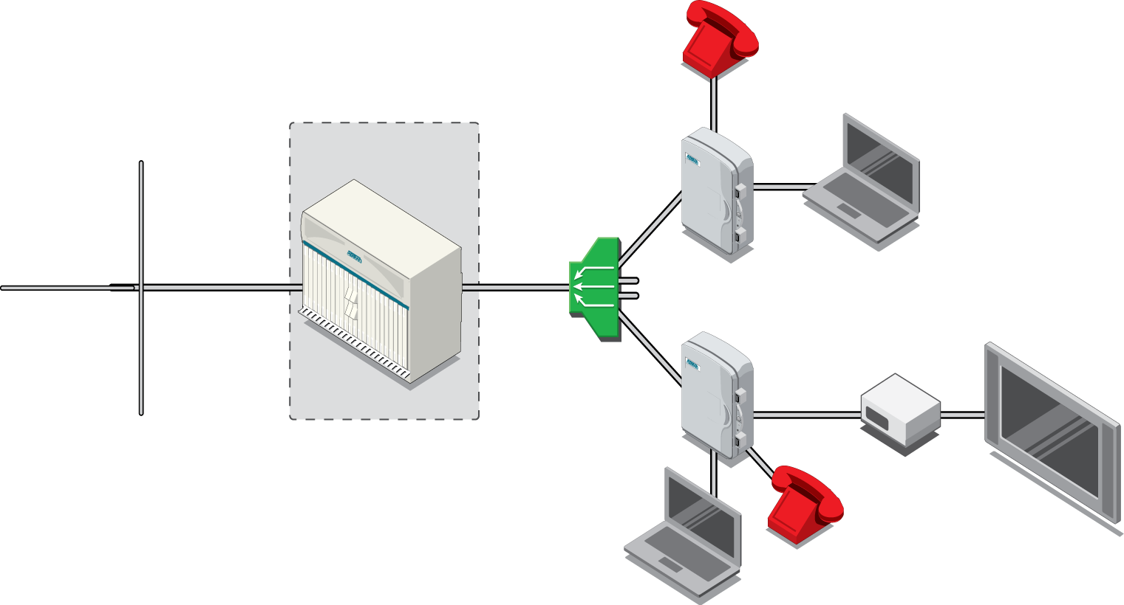
GPON Reference Architecture
Phone
Internet
ONT
Central Office
Internet
IPTV Head END
IP Core
Splitter
OLT
Set-Top
Box
HDTV
Voice Switch
ONT
Total Access 5000
Optical Line Terminal (OLT): at the TA5K
Optical Distribution Network (ODN): Fiber / Splitter
Optical Network Terminal (ONT): at the customer premises
Phone
Internet
Notes:
A PON consists of a central office node, called an optical line terminal (OLT), one or more user nodes, called optical network units (ONUs) or optical network terminals (ONTs), and the fibers and splitters between them, called the optical distribution network (ODN). ONT is an ITU-T term, whereas ONU is an IEEE term.
The splitter can be up to a 32-way split serving 32 residences from a single OLT GPON port. This splitter can be located anywhere, at the serving office or closer to the served area, reducing fiber costs. Individual fibers run from each residence back to the splitter.
In this type of network, subscriber’s voice, video, and data devices are connected to the GPON via the ONT.
The ONT formats IP data and analog voice into GPON Encapsulated Mode (GEM) frames and combines/splits the signal with analog and/or digital video to and from the OLT.

Slide 69
OMCI - ONT Management Control Interface
ONT Management and Control Interface
A GEM connection is established by the OLT when the ONT comes online, then OMCI runs across that connection
Establishes and release connections across the ONT
Manages the UNIs at the ONT
Request configuration information and performance statistics
Informs the system of events such as link failures
OLT manages the ONT
Defined by ITU specification G.984.4.
Provides for the encryption method, known as churning, that allows only the proper destination ONT to decrypt frames sent to it by the OLT.

Slide 70
GPON Overview Downstream GEM
OLT
ONT
VOICE
GEM1
GPON
Interface
GPON
Interface
GEM1
VOICE
UNI
INET
GEM2
DOWNSTREAM
GEM2
INET
VIDEO
GEM3
GEM3
VIDEO
GEM Port: A GPON Encapsulation Method (GEM) port is a virtual port for performing encapsulation for transmitting Ethernet frames or ATM cells between the OLT and the ONU/ONT. GEM is based on the ITU-T G.7041 Generic Framing Procedure.
Each different traffic-class (TC) per UNI is assigned a different GEM Port
an example could be:
GEM 0x101 = Voice (PBIT 5) for ONT #1
GEM 0x102 = Internet (PBIT 0,1,2) for ONT #1
GEM 0x103 = Video (PBIT 3,4) for ONT #1
Each GEM port is assigned a GEM-Port ID (0 to 4095) by the OLT. A GEM-Port ID can only be used once per OLT port. On the ADTRAN TA5000, downstream GEM-Port ID #1023 is reserved for Multicast traffic to ALL ONTs (IPTV).

Slide 71
GPON Overview Upstream GEM
In the upstream direction, GEM(s) are assigned into T-CONTs (traffic containers). Each TCONT is given a GRANT by the OLT as a “allowed time to transmit”. This GRANT is what gives each customer a specific (or varied by DBA) upstream speed.
OLT
ONT
TCONT1 GRANT
TCONT2 GRANT
GPON
Interface
GPON
Interface
GEM1
GEM1
TCONT
1
TCONT
1
GEM2
GEM2
GPON UPSTREAM
GEM3
TCONT2
TCONT2
GEM3

Slide 72
GPON Overview - Downstream
1xN
ONT #1
ONU-ID
0
Pin #: 1234
Pin #: 1234
DOWNSTREAM
OLT
ONT #2
ONU-ID
1
DOWNSTREAM
DOWNSTREAM
ONT #3
ONU-ID
2
Pin #: 1234
DOWNSTREAM
All Downstream traffic is “seen” by all ONTs. This is a potential security concern for Unicast traffic.

Slide 73
GPON Overview - AES
1xN
ONT #1
ONU-ID
0
HI MOM@ONT#1
KEY0
DOWNSTREAM
OLT
KEY0
ONT #2
ONU-ID
1
KEY0
DOWNSTREAM
DOWNSTREAM
KEY1
ONT #3
ONU-ID
2
KEY0
DOWNSTREAM
KEY2
AES Encryption is used to secure UNICAST traffic.
Only the ONT with the correct decryption key can decode the packet.
Encryption keys are exchanged during ONT Activation and every 30 minutes thereafter.

Slide 74
GPON Overview - Upstream Grants
1xN
ONT #1
ONU-ID
0
OLT
UPSTREAM
UPSTREAM
ONT #2
ONU-ID
1
UPSTREAM
We use a dynamic form of TDMA (Time-Division Multiple Access), where each ONT is periodically allocated a time-slot to transmit in. This process is called a “GRANT”
The OLT is always in charge and will change grant timing based on several variables.
A malfunctioning ONT can go “Rogue” by transmitting outside of its grant.
ONT #3
ONU-ID
2
UPSTREAM

Slide 75


GPON Overview Upstream DBA
What happens when more bandwidth is allocated than is actually available on the PON? For example, when 3x 1G upstream customers are on the same PON and all need to send 1Gb of traffic upstream?
1xN
ONT #1
ONU-ID
0
UPSTREAM
1Gb
OLT
ONT #2
ONU-ID
1
1Gb
UPSTREAM
UPSTREAM
ONT #3
ONU-ID
2
1Gb
DBA – Dynamic Bandwidth Allocation
steps in and the OLT GRANTs a “fair” amount of bandwidth to each ONT until their queues are empty.
UPSTREAM

Slide 76
The Future of PON (NG-PON2)
The future of PON relies on WDM-PON solutions like NG-PON2 (defined by ITU-T G.989). We can provide customers with their own wavelength, which could allow >10Gbps symmetrical data transfer.
10Gbps symmetric
Optical budget similar to GPON B+
Nominal 32 splits at 20km
Can coexist with GPON on same ODN
Supports multiple 10G PONs on same ODN at different wavelength pairs
Easy capacity expansion
Fixed or tunable (colorless) optics
Standard allows a single ONT to tune across 4 wavelengths
Supports adding point-to-point wavelengths
Dedicated bandwidth, optical P2P on physical PON ODN
10Gbps downstream, 2.5 Gbps upstream also possible.
Makes rollouts and migration easier
Multiple services can be multiplexed onto the same ODN. This keeps outside plant costs to a minimum
Each group gets their own wavelength with, instead of a 20nm band like upstream GPON, one band at less than 1nm spacing.
4-8 TDM
PON λs
+
WDM
Overlay λs
=
NGPON2
The tunable optics are expensive. How do we provide 10G service before prices come down?

Slide 77
The Future of PON (XGS-PON)
What about a bridge between the changes for NG-PON2 and current GPON?
XGS-PON bridges the gap.
10Gbps symmetric
Optical budget similar to GPON B+
Nominal 32 ONTs at 20km
Can coexist with GPON on same ODN
Allows 10G service without major network changes
Can use 10G EPON wavelengths (1577nm downstream, 1270nm upstream)
Can also use traditional GPON wavelengths for greenfield installations
Only changes are OLT and ONT hardware
Provisioning nearly identical to GPON process
Same bandwidth per PON as NG-PON2
Support for up to 64 ONTs
GPON and XGS-PON co-existence with CWDM
GPON
XGS-PON
1490/1310
1577/1270
CWDM
splitter
GPON ONT
XGS-PON ONT

Slide 78
Questions?

