Slide 1
Safety
When
Working Aloft

Slide 2
Working Aloft
Where does safety start?
Senior leadership
Has to set the tone for a safe work environment
Mid-level managers
Need to enforce the correct attitude
Everyone
Needs to think safety first
Needs to work safely
Needs to make sure others around you are working safe
If you see someone not working safely, say something!

Slide 3
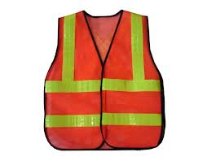
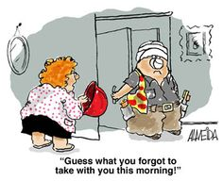
Personal Protective Equipment
ANSI Z89.1 approved hardhat must be worn
All field employees are required to wear steel shank boots
ANSI Z87 approved safety glasses are required
Class 2 high visibility safety apparel must be worn while working within the “right of way”
Class 3 must be worn during nighttime operations

Slide 4
Electrical Safety
No employee shall approach or take any conductive object closer to any electrically energized overhead power lines than:
300 V or less…………………………………..…………Avoid Contact
Over 300 V, not over 750 V……………………..12 inches
Over 750 V, not over 2 kV………………………..18 inches
Over 2kV, not over 15 kV…………………………24 inches
Over 15kV, not over 37kV………………………..36 inches
Over 37 kV, not over 87.5 kV……………..……42 inches
Over 87.5 kV, not over 121 kV…………………48 inches
Over 121 kV, not over 140 kV………………….54 inches

Slide 5
Electrical Safety
AC Voltage Probe
The AC Voltage Probe is a hand-held device for detecting the presence or absence of 50-1000 volts AC.
No contact is required for operation and current flow is not necessary to locate voltage.
If AC voltage is present, the tip will glow red and you will hear an audible tone.

Slide 6
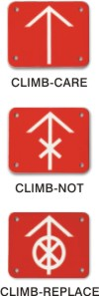
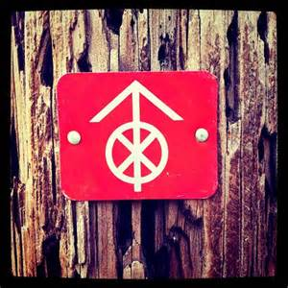
Utility Poles
“DO NOT CLIMB” Tags:
Look for tags or a painted X on the pole which identify the pole as unsafe.
Do not use a ladder on these poles!
Become familiar with the marking system used by the utility companies in your service area.

Slide 7
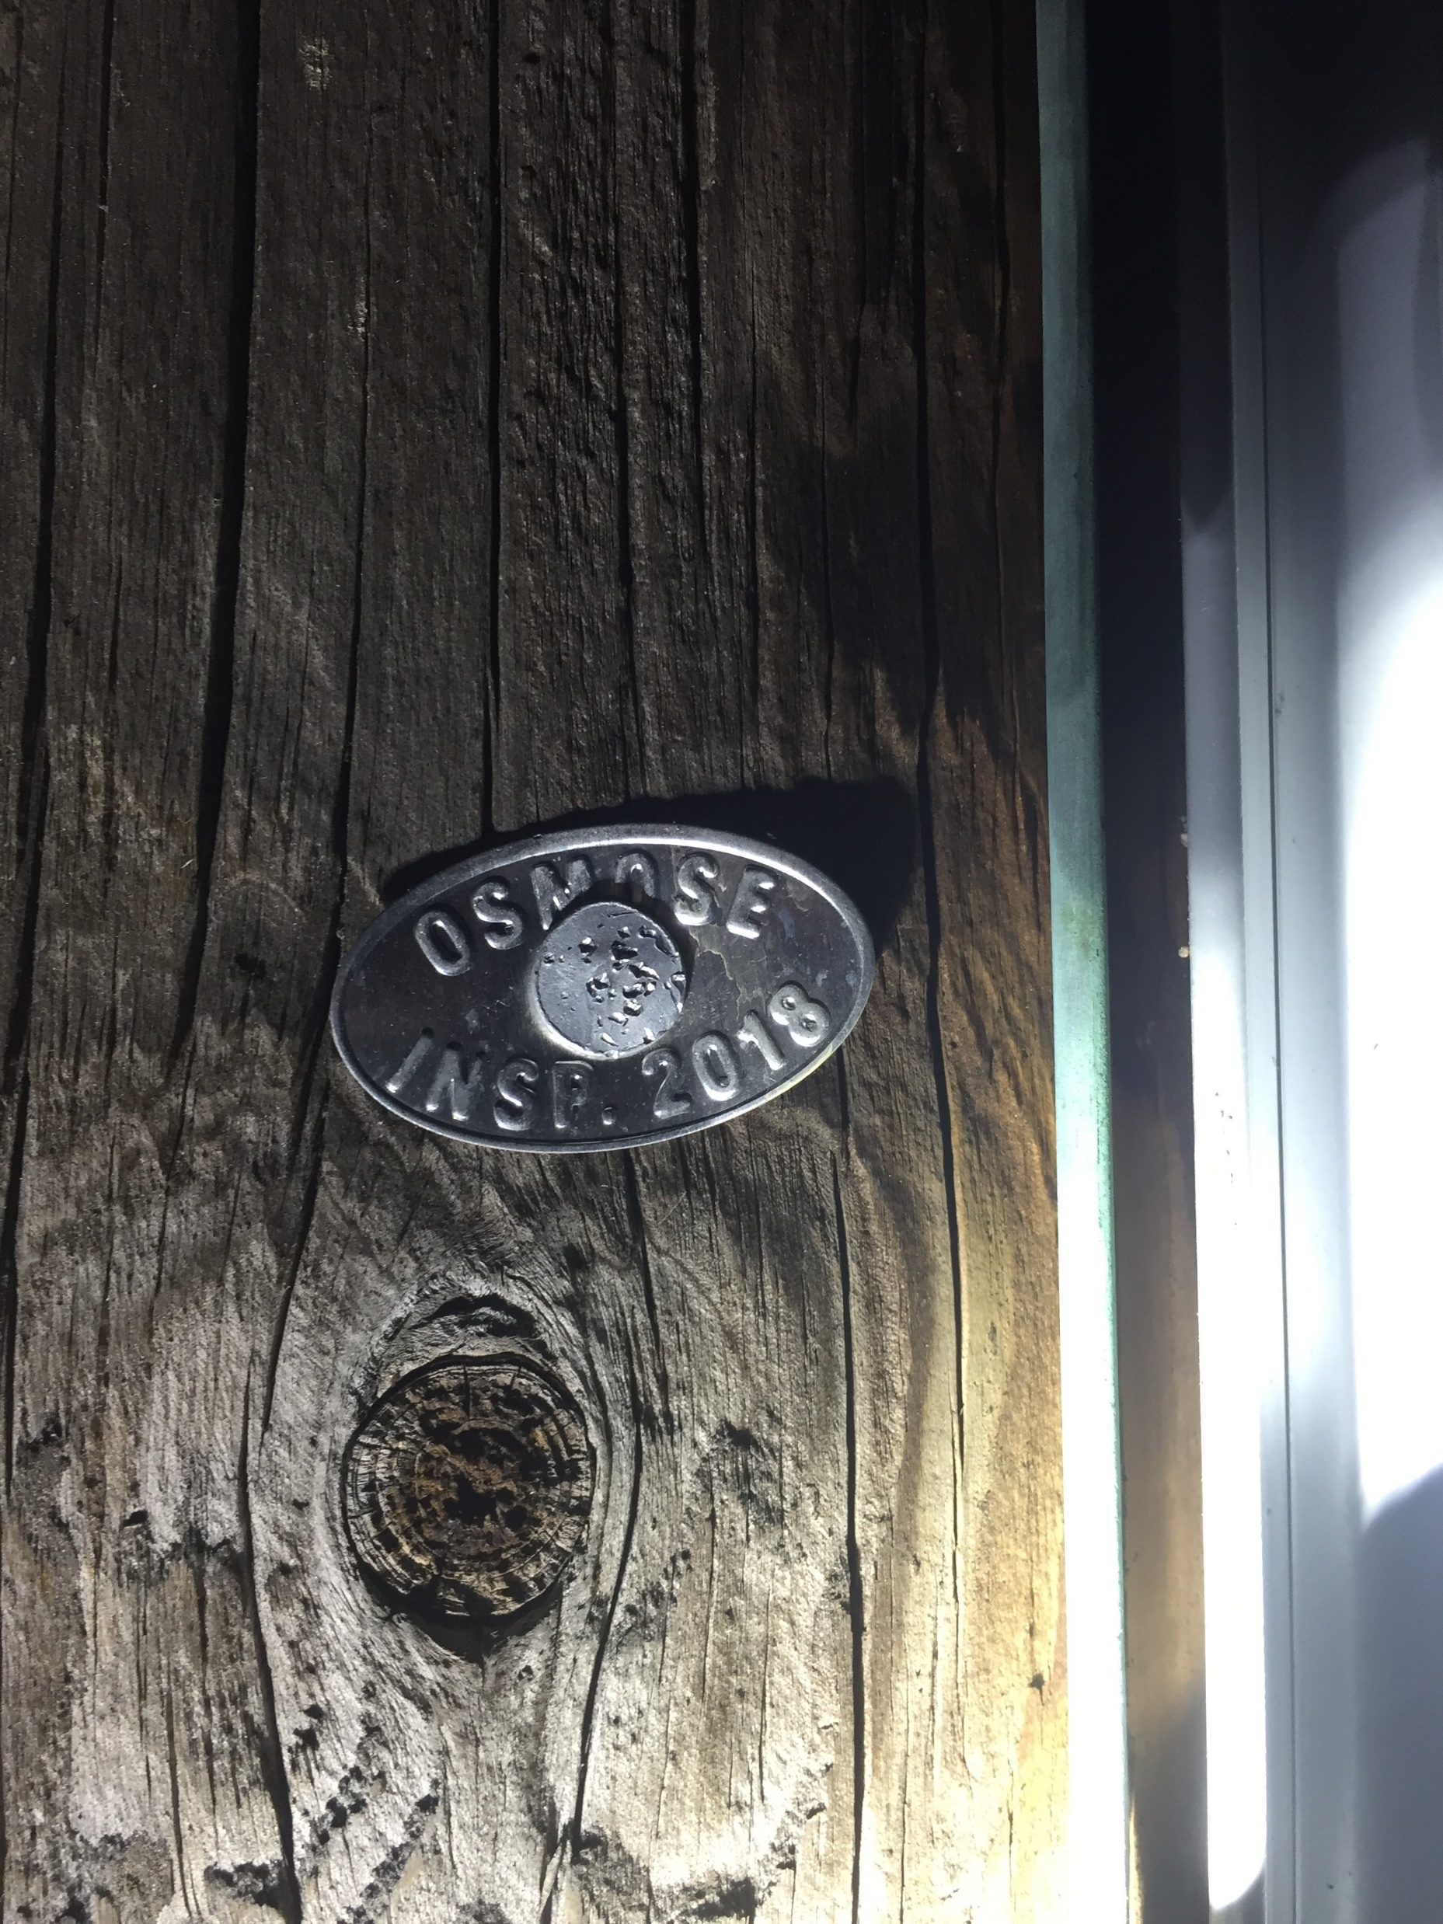
Utility Poles
When should you test a pole?
Would you take the time to test this pole?
Inspected in 2018
Pole looks in good shape, right?
Lets look at another picture of the same pole

Slide 8
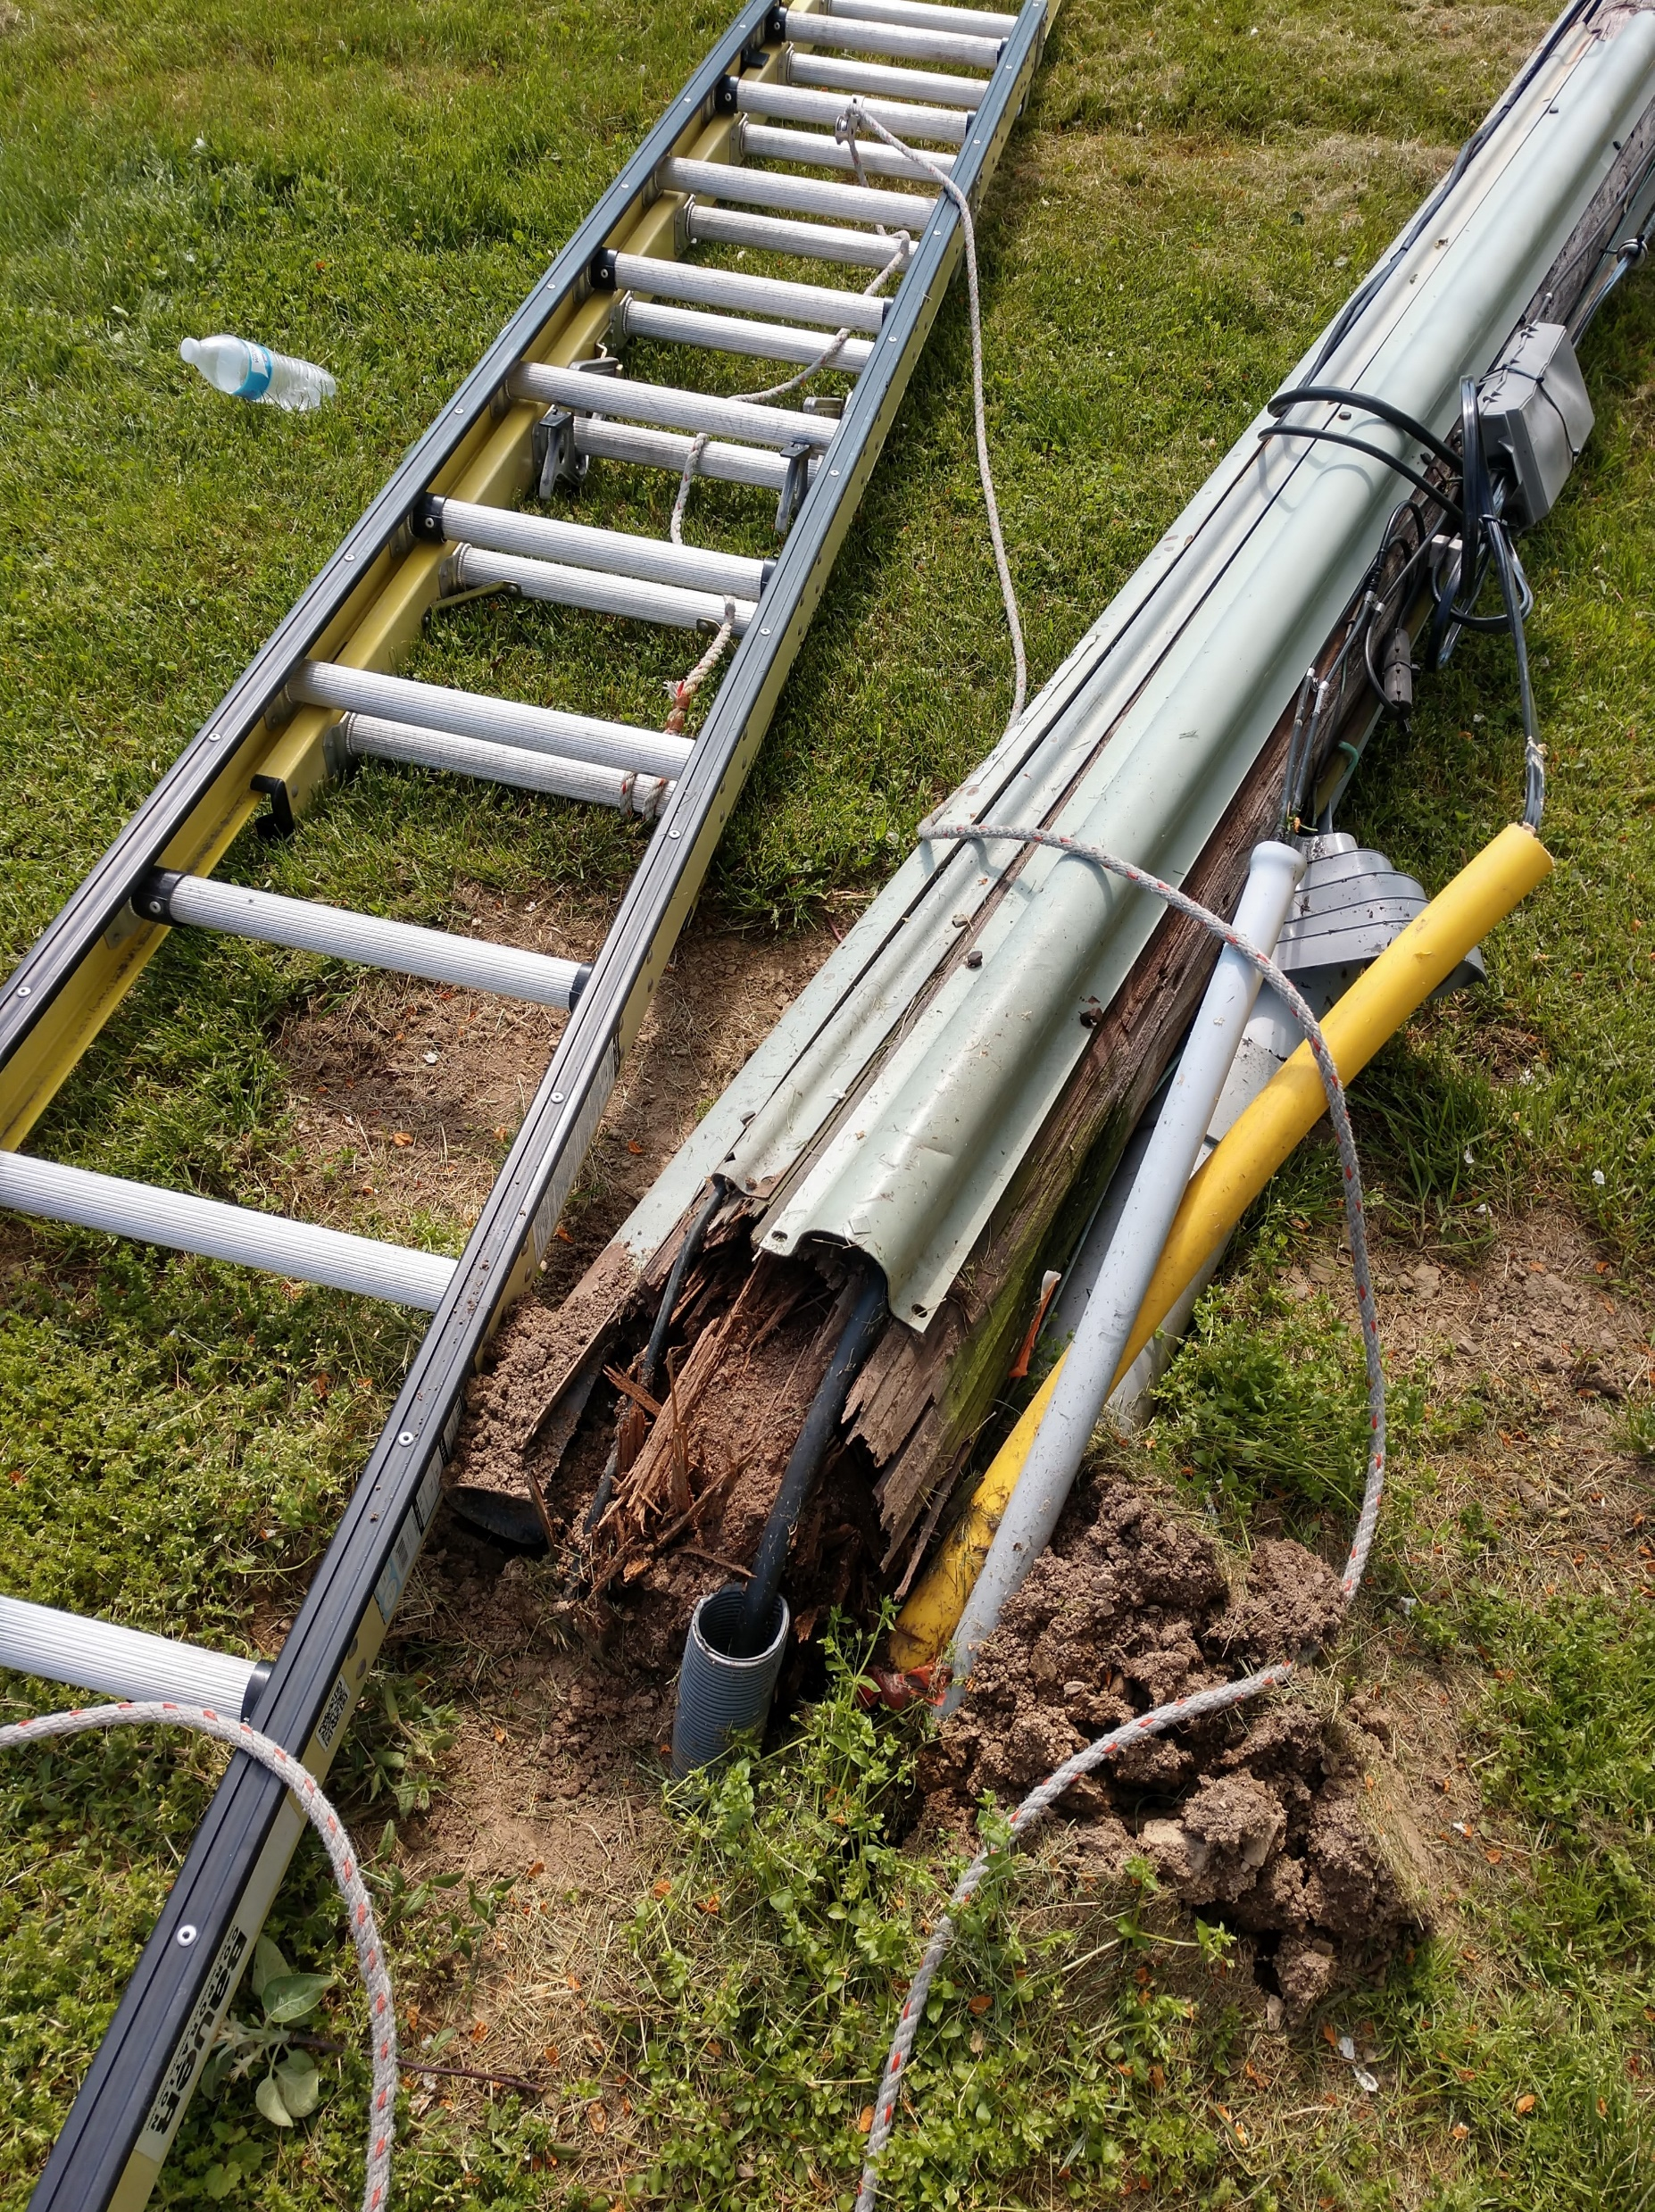
Utility Poles
When should you test a pole?
Yes, same pole, same day!
This happened in 2019
Probably within months of being tagged!
A Tech was injured in the fall
How could this accident been avoided?
Better inspection techniques?
Pole testing by Tech?

Slide 9
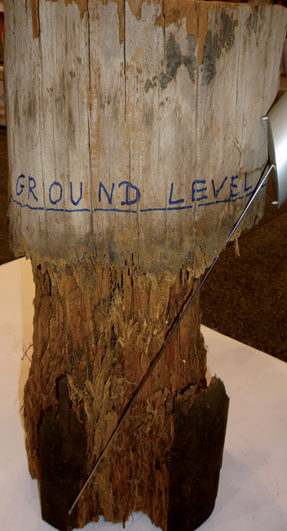
Utility Poles
Pole Tests
After a visual inspection, one or more of the following tests should be
Prod Test
Hammer Test
Rocking Test
Structural damage is often hidden from view.
These tests will expose hidden problems

Slide 10
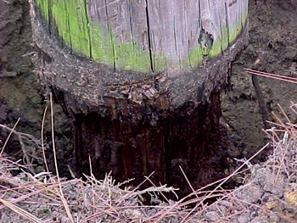
Utility Poles
Prod Test
The prod test is used to check the base of the pole for rot.
Jab a screwdriver into the pole about 2" below ground level.
If it penetrates easily, clear away the dirt for further inspection.
Test the circumference at approximately 2" intervals.

Slide 11
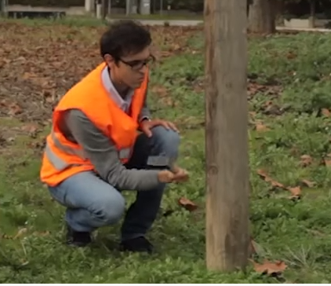
Utility Poles
Hammer Test
Starting near ground level, strike repeatedly around the circumference of the pole.
A solid sound indicates good wood.
A hollow sound indicates core rot
slapstick sound indicates shell rot.
What do you see wrong in this picture?

Slide 12
Utility Poles
Rocking Test
Apply a horizontal force to the pole
rock it back and forth in a direction perpendicular to the line.
Exercise caution to avoid causing power lines to swing together.
Apply the force to the pole
Push it with a pike pole, ladder, or pulling the pole with a rope.
If you hear the pole cracking during the test, it is unsafe.

Slide 13
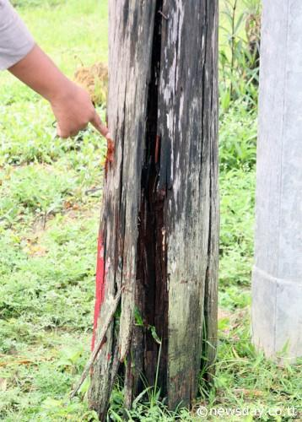
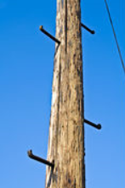
Utility Poles
Elevator Shafts & Stepped Poles
Elevator shafts
If a stepped pole has elevator shafts, the steps may be loose and not be able to support a climbers weight.
Climb stepped poles with caution. Use a climbing strap well climbing stepped poles to maintain fall protection

Slide 14
General Ladder Usage
Belting on
A positioning belt and lanyard must always be used.
At the pole
Lanyard should be passed through the ladder and around the pole and attached to the D-rings on the positioning belt.
Whenever possible, the lanyard should be passed around the pole over top of the strand.
On a Mid-span
The lanyard should be wrapped around the strand and ladder before attaching to the D-rings on the positioning belt.

Slide 15
General Ladder Usage
Extension and Straight Ladders
Handling
A solid, confident ladder carry is essential.
insure that accidents are avoided.
Avoid tree branches and other aerial obstructions.
Always inspect your walking route before taking the ladder off of your truck.
Use caution when moving ladders in high traffic areas.

Slide 16
General Ladder Usage
Extension and Straight Ladders
Ladders should be setup at approximately a 4 to 1 ratio. That is for every 4 feet high the ladder extends, it should be 1 foot out at the base.
When a ladder is placed on the strand, the strand hooks must be “engaged” with the strand.
Avoid placing the ladder on or straddling a tap.
Extend the ladder at least three rungs (2 foot minimum) above any roof
Before placing a ladder against a wall, be sure to retract strand hooks.
Ladders should be tied off or secured in high wind situations.

Slide 17
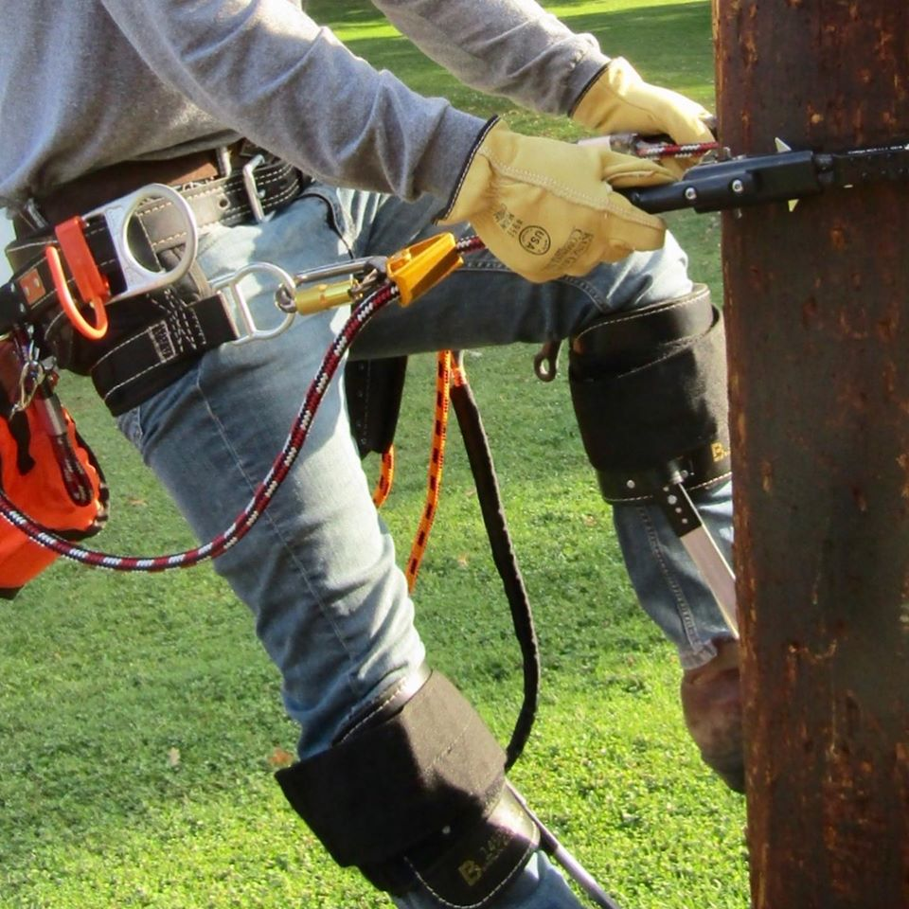
Pole Climbing Basic Safety
Always inspect your equipment before each use
Use pole cinch lanyard and a secondary for 100% fall protection
Keep the gaffs sharp and shaped correctly
Use gaff guards when climbers are not being used

Slide 18
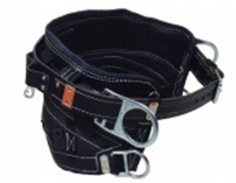
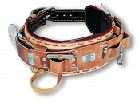
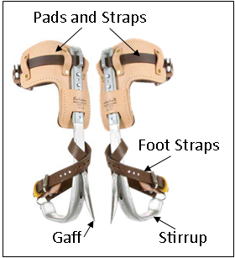
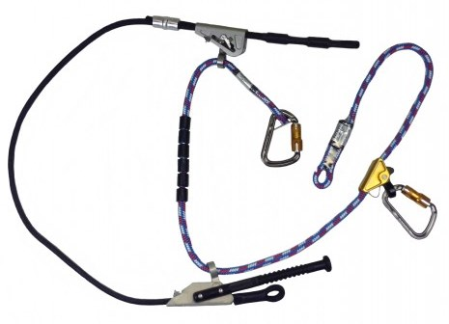
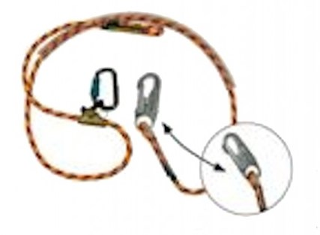
Pole Climbing
Basic Equipment
Body Belt
Pair of Climbers
Patriot Fall Restricting Device
Secondary Safety Lanyard

Slide 19
Pole Climbing Obstacles:
Avoid signs and other things which may be attached to the pole.
Anything that reduces the ability to either grip the pole with the hands or provide adequate space for the feet should be avoided.

Slide 20
Aerial Lift Truck Safety

Slide 21
Aerial Lift Truck Safety
Inspection
Inspection Report needs to be carried in vehicle while in use
If anything is found deficient, the truck needs to be removed from service until repaired
Lift and truck need to be inspected daily before use
Example of a visual inspection
Chassis
Lift
Other items

Slide 22
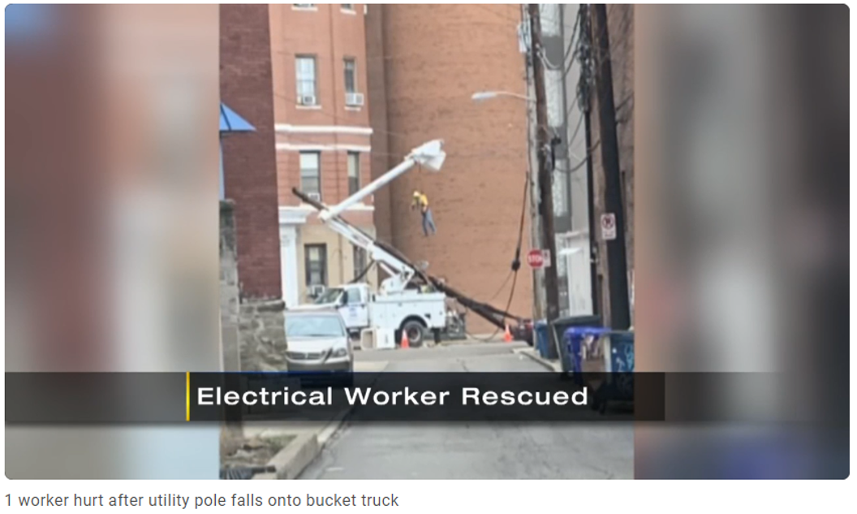
Aerial Lift Truck Safety
https://www.wpxi.com/news/top-stories/1-person-taken-hospital-after-pole-falls-onto-bucket-truck/VVVMU4WRKJBHXCLOCK673DIZSM/

Slide 23
Suspension Trauma
What is it?
When hanging in a fall harness, the leg straps support the body’s weight.
During this time, the leg straps of the harness crush the femoral arteries on the inside of the legs, cutting off blood circulation.
When the leg muscles are relaxed, veins in the legs can expand dramatically.
The leg muscles are not being used to stand up, they are not contracting, so veins expand.
This allows blood to gather in the legs rather than returning to the heart and lungs for recirculation.
This can result in a 20 percent loss in blood circulation.

Slide 24
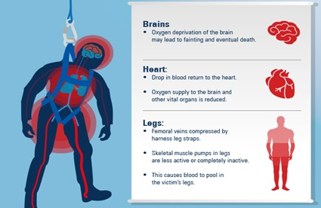
Suspension Trauma
Circulatory Shock
The loss of circulation causes the heart to work harder to keep the brain and vital organs supplied with blood.
This results in nausea, unconsciousness, and a drop in blood pressure and heart rate.
This is the onset of circulatory shock.

Slide 25
Suspension Trauma
Dangers
Without circulation in the legs, lactic acid builds up
This is then released when the worker is brought down and circulation restored.
High levels can overwhelm the kidneys, liver, and even result in heart failure.
In a technical bulletin, OSHA identified that suspension trauma could be fatal within 30 minutes of the initial fall.
29 CFR 1926.502 (d) (Fall Protection Systems Criteria and Practices).
OSHA requires "prompt rescue of employees in the event of a fall or shall assure that employees are able to rescue themselves."

Slide 26
Suspension Trauma
Rescue
In standard first-aid training you lie someone down when they have fainted and raise their legs. This will cause all the acidic blood rush back into the body at one time.
If a suspension trauma victim is lain down, even for a short time, they can die of a heart attack or suffer multiple organ failure.
Anyone helping during rescue must stop medical staff from doing this at all costs and explain why.

Slide 27
Suspension Trauma
Proper Treatment
Lower victim into a sitting position for a minimum of 30 minutes
so acidic blood is released gradually.
Anyone suspended for more than 10 or 15 minutes will have dangerously high levels of acidic blood in their legs.
If their heart survives the rescue, other organs can be damaged.
Anyone who has suffered from suspension trauma must be sent to hospital for a check-up.

Slide 28
Review
Safety starts at the top, but everyone is responsible for working safe!
Use the education, tools, and protective equipment provided
be aware of your surroundings and the conditions you are working in
Always base decisions on safety

