Slide 1
5G Overview and Testing Requirements
.
Jeremy Davis – Solutions Engineer
May 23rd, 2019
Notes:
Last updated by Corporate Marketing on September 1, 2016.

Slide 2
Agenda
5G Overview
Network Topology
Network Testing
Questions
Notes:
This APJ Partner training is all about hands-on and competitive
We have heard your voice
Partners need to gain more confidence in hands-on competitive scenarios rather than just reading paper analyses
We had consolidated your input, and worked hard to bring in competitor units that you frequently compete against
Please give 100% effort to maximize this opportunity to learn
Ask partners to look out for untapped adjacent markets (be it lower dynamic range/ lower price/ special feature request/ etc that we do not offer today)
Provide qualitative and quantitative input to VIAVI when raising requests <- I’m not getting a lot of feedback from the OTDR survey distributed earlier.
We have added Field calibration services for a more comprehensive solution, this will give us additional flexibility and reach to offer bundles and upsell and re-farm old installed base <- JX will cover more details in the Executive Track

Slide 3
5G Overview

Slide 4
Introduction to 5G Radio Access
5G technology is based on orthogonal frequency division multiple access (OFDMA) transmission technology, similar to LTE, supporting data modulation from QPSK to 256QAM; however, it incorporates additional flexibility, for example:
Frequency operating bands: :
Frequency Region 1 (FR1) for sub-6GHz
Frequency Region 2 (FR2) for millimeter wave (mmWave) between 24GHz and 52GHz
Channel bandwidth: flexibility for wider channel bandwidth configurations;
FR1 range is from 5MHz to 100MHz
FR2 is from 50MHz to 400MHz
Carrier aggregation: capability to aggregate two or more component carriers to increase channel bandwidth
Beam forming: ability to generate and shape multiple beams based on phase and amplitude to direct radiated power to the user’s serving area

Slide 5
5G RAN Revolution Massive MIMO and Beamforming
M-MIMO and Beamforming Benefits
Massive MIMO is well suited for higher frequency bands (mmWave), allowing a high array of antennas into a small panel or area.
Beamforming improves signal to noise ratio (SINR) concentrating the energy through narrower beams, as well as creating constructive interference (diversity) overlapping multiple beams to improve propagation.
Massive MIMO
100 m
LTE-A
20cm
Beamforming
20cm

Slide 6
5G Radio Access Communication Modes
Time
Frequency Band | Tx/Rx Mode
FR1 < 3GHz | FDD, TDD, SDL, SUL
FR1 > 3GHz | TDD
FR2 | TDD
UL
Power
DL
DL
3560 MHz
Freq
TDD: Time Division Duplex
Time
Time
DL
Power
DL
Power
UL
UL
739 MHz
751 MHz
751 MHz
782 MHz
782 MHz
Freq
Freq
FDD: Frequency Division Duplex
SDL: Supplemental Downlink

Slide 7
5G RADIO ACCESS TECHNOLOGY ELEMENTS
Source: Nokia

Slide 8
5G Network Topology

Slide 9
5G brings deeper fiber in fronthaul
Operators are now recognizing that fiber is imperative for a successful 5G rollout.
Symmetric speeds of 1 to 10Gbps and latency of 1 millisecond are required
Average Fiber Count (AFC) in the cable must be increased
5G will require a 20-30 times increase in the number of small cells, Exponential impact on fiber end points.
5G could use PON feeds but design considerations needs to be made on bandwidth availability.

Slide 10
Fiber Densification Changes the Game
Upgrade from 3G to 4G/5G with fiber densification, more frequent BBUs and Antennas
Ideal: Reuse old fiber if performance is acceptable but some will have to be replaced or added
More points of failure with higher split ratio from RU to BBU and more fiber legs to maintain
Reduced optical loss budgets compared to 3G and 10G is more susceptible to reflectance that distorts the signal
Antenna locations are more vulnerable to roadside accidents
More distribution, path issues.

Slide 11
Backhaul, Fronthaul, and CRAN
Cell Site
Core Site
Central Site
MACROCELL
Mobile Switching Center
RRU
(Radio Radio Unit)
FTTA (Fiber to the Antenna)
Backhaul
BBU
(Baseband Unit)
BSC/RNC SGW/MME
SMALL CELLS
Mobile Switching Center
Fiber
Backhaul
COAX
RF
BSC/RNC SGW/MME
Centralized/ Cloud
RAN
RRU
Fronthaul
Mobile Switching Center
Base Station Hotel
Backhaul
BSC/RNC SGW/MME

Slide 12
xHAUL Evolution: Migration for BOTH 4G and 5G
Today:
Backhaul
CU
Midhaul
DU
Fronthaull
RU
Tomorrow:
eS1/Ethernet
F1
eCPRI
RRC
PDCP
High RLC
Low RLC
High MAC
Low MAC
High PHY
Low PHY
RF

Slide 13
Look Similar?
Measures the fiber performance and the quality of any fiber optic interconnections to support migration to 10GE or 100GE transmission
Headend
Hub
Node
vCMTS
100/10G
Transport optical link
10GE DWDM
optical link
Test Port
OTU 8000
T-BERD/MTS
T-BERD/MTS
T-BERD/MTS
Fiber Centralized Test Head
DWDM route validation
Fiber link commissioning at the Hub or at the node

Slide 14
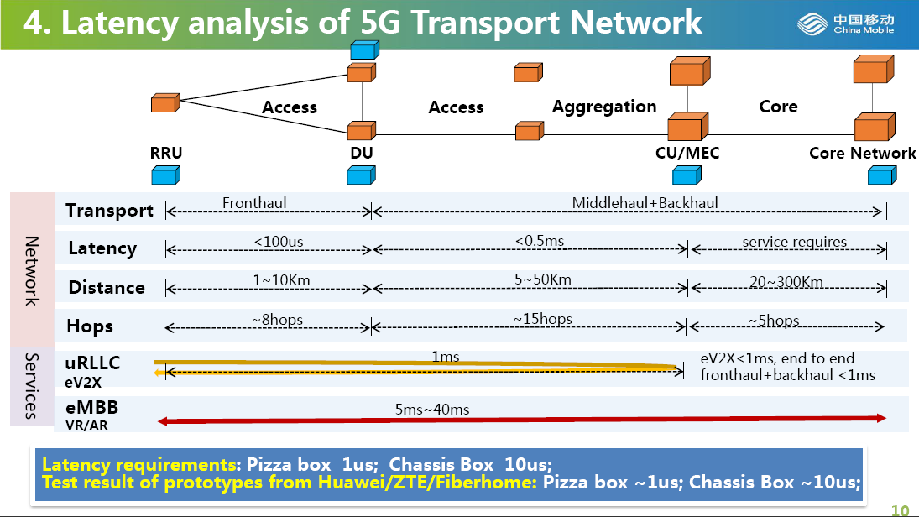

Slide 15
Network Testing

Slide 16
Testing Challenges
Fiber Condition and Continuity
New WDMs added to network
Simply more fiber deployed
Traditional test equipment cannot test through WDMs
Dispersion
Dispersion parameters matter for 10GE transmission
Must select best existing fiber route
Cover the baseline to ensure fiber can support new signals – must characterize
High Fiber Count Cables
More time required to certify
Optimized and efficient test tools and procedures
Single contaminant can create greater impact

Slide 17
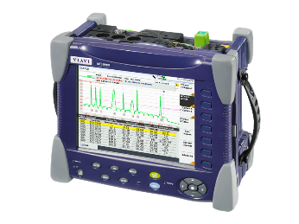
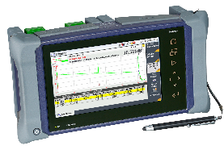
Test Workflow
Connector Inspection
Best practice, ensure connectors are ALL clean
Outside Plant Fiber Characterization
Know the baseline performance of your network.
Fiber Commissioning
Certify fiber deployment (splicing, loss, continuity…)
Dispersion Testing
Validate fiber can support 10GE signals.
DWDM
Charac.
Required for DWDM continuity and loss budget
DWDM-Ready Validation
Qualify DWDM routes with DWDM components (MUX, DEMUX…)
DWDM
Routing
Confirm End-to-End continuity and channel drop

Slide 18
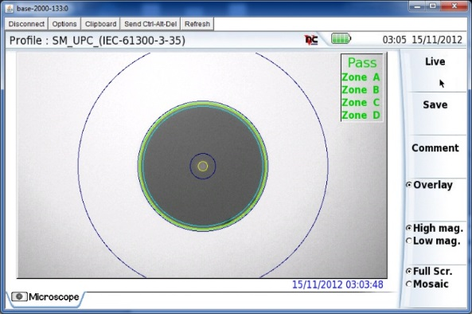
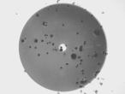
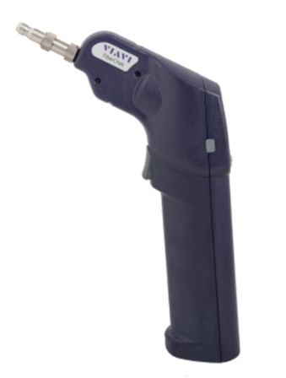
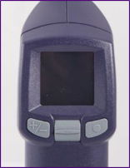
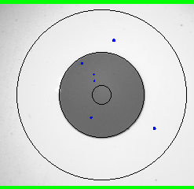
Fiber Inspection
FiberChek Probe, Sidewinder or P5000i
“Inspect Before you Connect”
Reduce Network Downtime
Reduce Troubleshooting
Optimize Signal Performance
Prevent Network Damage
Auto-Centering/Auto Focus
Test Objectively and Consistently to IEC Standards – No Subjectivity
Automated Pass/Fail Results
StrataSync results/data management

Slide 19
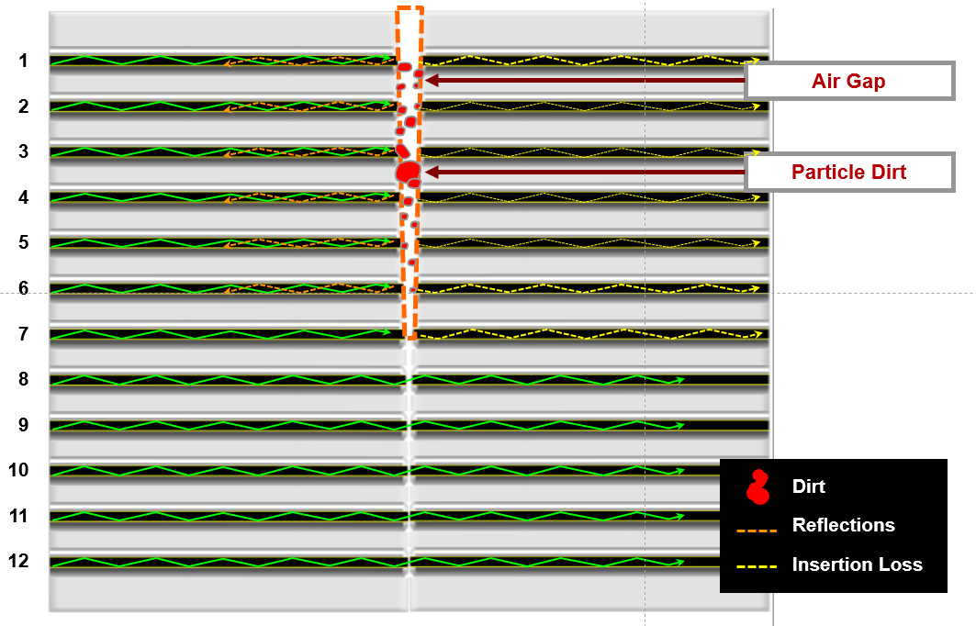
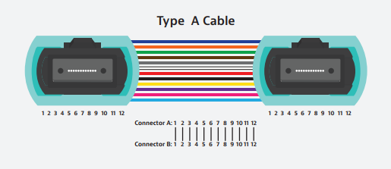
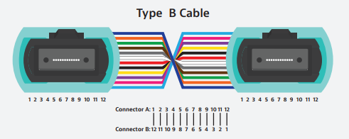
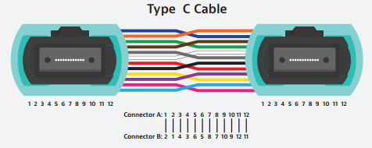
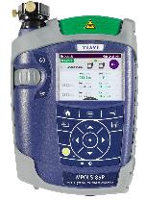
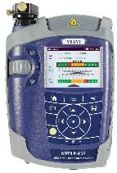
MPO Inspection and Certification
Verify Cleanliness of all Bulkhead and Patch Cord Connections
ORL/IL on all Fiber Paths
Identify Link Polarity – Detect cross-over issues – All Links, Adaptors, Patch Cords
Length Measurement enables application testing (40G-SR4 vs 100G-SR4)

Slide 20
Fiber Characterization
Measures the fiber performance and the quality of any fiber optic interconnections to support migration to 10GE or 100GE transmission
Headend
Hub
Node
vCMTS
100/10G
Transport optical link
10GE DWDM
optical link
Test Port
OTU 8000
T-BERD/MTS
T-BERD/MTS
T-BERD/MTS
Fiber Centralized Test Head
DWDM route validation
Fiber link commissioning at the Hub or at the node

Slide 21
Fiber Characterization Qualifying fiber for high speed transmission
Test Parameters | Measurement
Connector Inspection | Inspection Scope
Bi-directional Insertion Loss measurement | Loss Test Set
Bi-directional Optical Return Loss (ORL) measurements | Loss Test Set
Bi-Directional connectors/splice measurements | OTDR
Distance Measurement | OTDR
Reflectance measurements | OTDR
Polarization Mode Dispersion (PMD) measurements | PMD analyzer
Chromatic Dispersion (CD) measurement | CD analyzer
Attenuation Profile (AP) measurements | Spectral Analyzer
A comprehensive suite of point-to-point physical layer tests
Performed during the fiber installation, final commissioning as well as upgrades
Maximization of existing fiber plant – Mesh network, different fiber types
Loss budgets are tighter – need precise loss measurement – Bi-directional testing
CU
RU

Slide 22
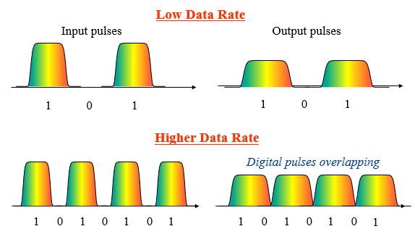
CD/PMD Overview
Both CD & PMD can become an issue as you move to Higher Data Rates (10G+)
Chromatic Dispersion (CD)
Different wavelengths (colors) travel at different speeds down the fiber causing the pulses to spread
1x measurement (doesn’t change)
Polarization Mode Dispersion (PMD)
Different polarization modes travel at different velocities causing a Differential Group Delay (DGD) resulting in pulse broadening
PMD varies with time, T°, movement
Notes:
One last fiber testing area I wanted to briefly mention is Dispersion Testing.
This testing comes into play when you start putting 10G or higher data rates on the fiber (typical for DAA deployments such as R-PHY).
Dispersion causes the pulses (the “Ones”) to spread out as they travel down the fiber- and with 10G and higher traffic since those pulses are so tightly spaced it can actually result in the pulses overlapping and cause errors or failures.
There are 2 types of Dispersion that need to be tested- Chromatic Dispersion (CD) and Polarization Mode Disperion (PMD).
For CD think of the wavelengths as different colors of light and those colors travel down the fiber at different speeds and cause the pulse to spread out as it travels down the fiber.
For PMD think of the pulse as 3 dimensional. The horizontal axis of the pulse will travel down the fiber at a different rate than the vertical axis which causes the pulse to spread out as it travels down the fiber.
Of course theres test equipment made that can test for both of these dispersions. This becomes more critical as you move into DAA deployments such as Remote PHY.

Slide 23
Dispersion Parameters
Transmission limits determined by the network equipment manufacturers and related to the type of transmission, speed and coding format being implemented.
Transmission Type | Transport Speed | PMD Max | CD Max
SONET | OC-192/STM-64 | 10 picoseconds | 1176 ps/nm
Ethernet | 10 Gb/s | 5 picoseconds | 738 ps/nm
SONET | OC-768/STM-256 | 2.5 picoseconds | 64 ps/nm
Ethernet Coherent detection | 100Gb/s | 25 picoseconds | 30000 ps/nm
Ethernet Non coherent detection | 100Gb/s (4x25 Gb/s) | 1.0 picoseconds | 500 ps/nm
Main dispersion thresholds according to the transmission rate

Slide 24
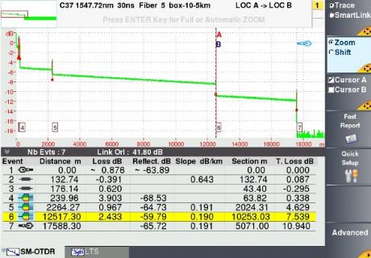
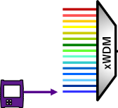
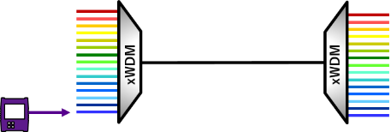
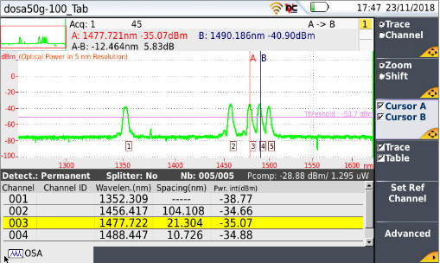
DWDM Link Qualification
DWDM route validation
Component and
End-to-end loss
xWDM
xWDM
Continuity check
Power level

Slide 25
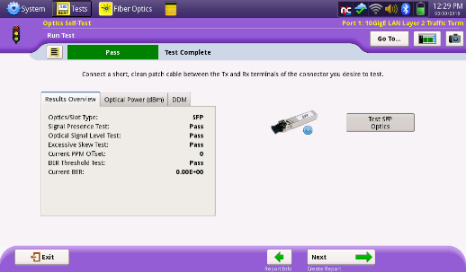
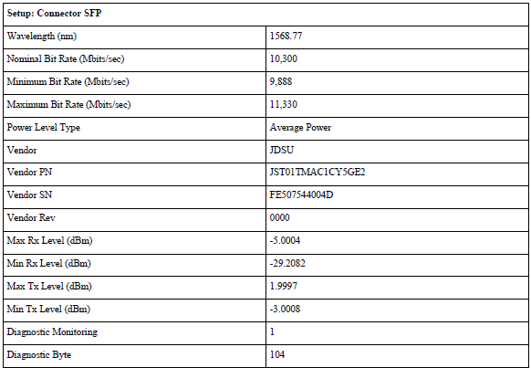
Optics Testing
Tune optic by wavelength, frequency, or channel number
Run BER test with optic in self loop
PDF report includes optics serial number and tuning information

Slide 26
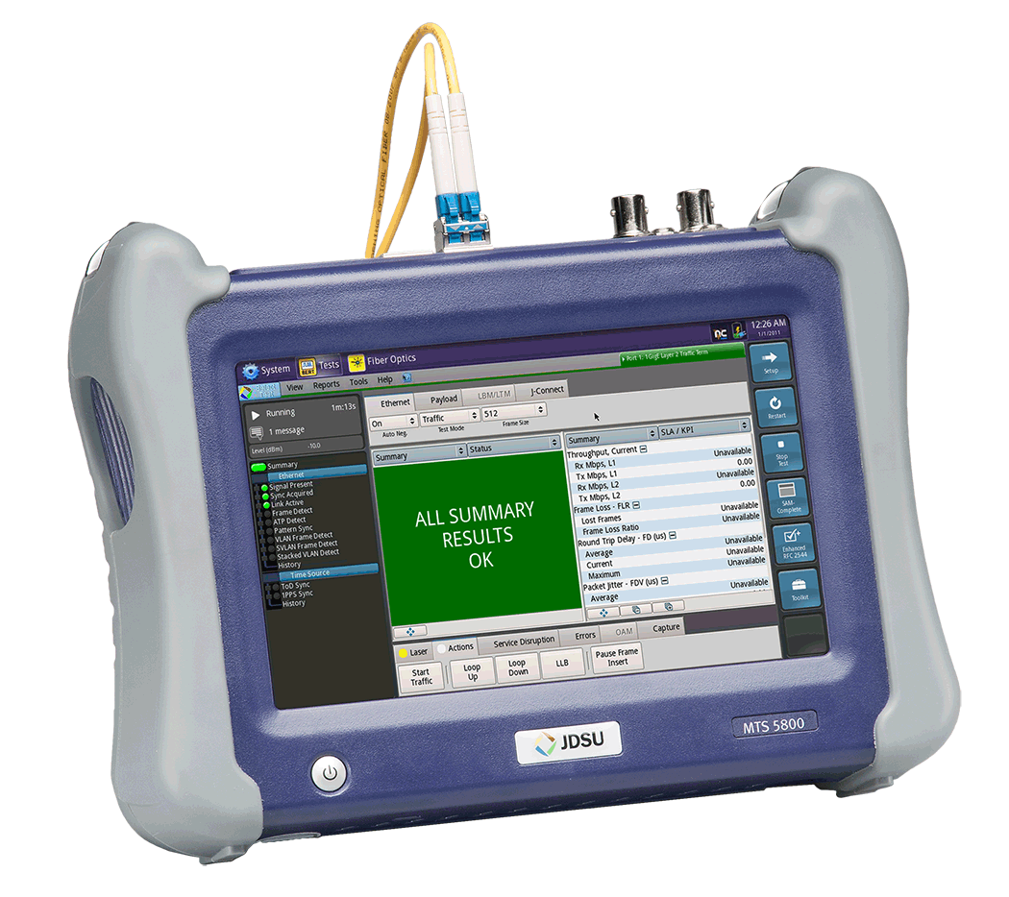
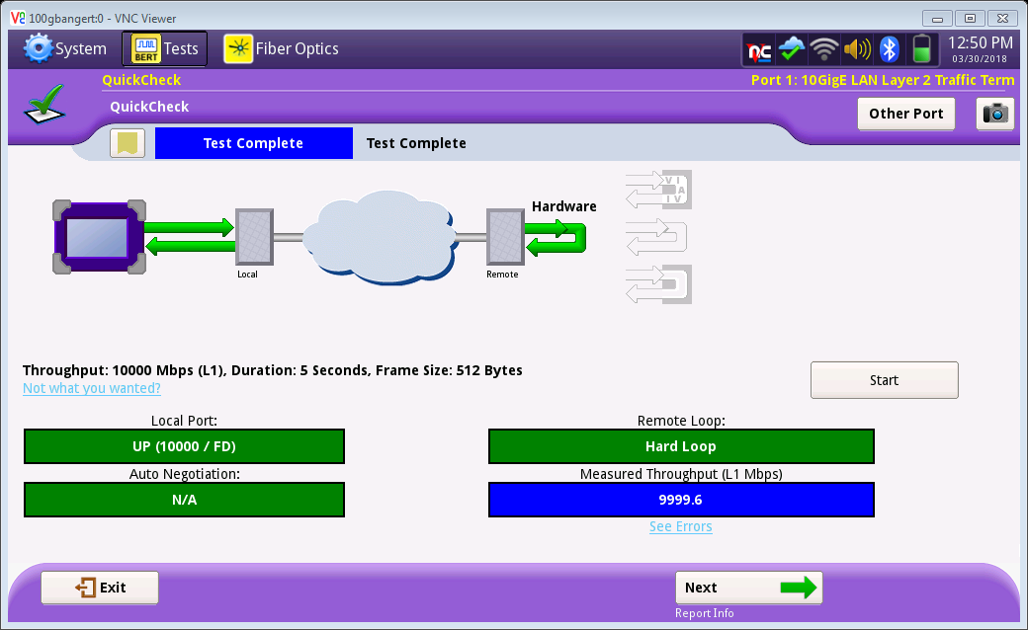
Network Connectivity and Throughput Testing
Test Connectivity from RPD location to CCAP location through active and passive components
Measure 10G throughput
Showing simplified QuickCheck, RFC 2544 or Y.1564 could also be used

Slide 27
Y.1564 SAMComplete
Newer industry standard for single and multiple service Ethernet and IP service activation test
Measure Key Performance Indicators and Bandwidth Profile
CIR, EIR (Throughput)
Frame Delay – FD (Latency)
Frame Delay Variation – FDV (Jitter)
Frame Loss Rate - FLR
Committed Burst Size – CBS
Policing
Fully automated with report generation

Slide 28
PTP use in Remote PHY (or 5G)
1. PTP Master - source of truth for timing
4. Modems use timing information for upstream communications – 1 ms alignment required by spec
Network
PTP Master
RPD 1
Subscriber 1
vCMTS
RPD 2
Subscriber 2
2. vCMTS and all RPD devices receive their timing information from PTP master
3. Each RPD communicates timing information to modems via DTP

Slide 29
RF Testing

Slide 30
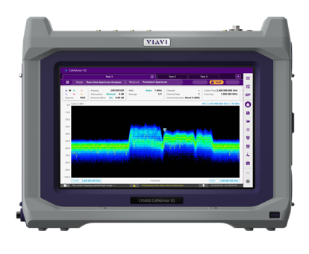
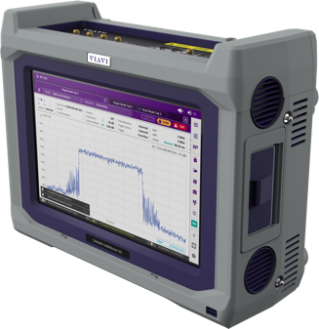
RF Testing
Interference Analysis (Real-Time Persistence Spectrum)
Real time spectrum analysis with persistence display
RFoFiber : Spectrum and Spectrogram
RFoAir : Spectrum and Spectrogram (FR1 or sub 6GHz and FR2 from 24GHz to 40GHz)
Signal Analysis (iBW 100MHz)
4G (LTE, LTE-Advance-Pro, NB-IoT, LTE-M), conformance verification, signal modulation quality.
5G carrier aggregation, signal modulation quality, beamforming assessment, and coverage profile

Slide 31
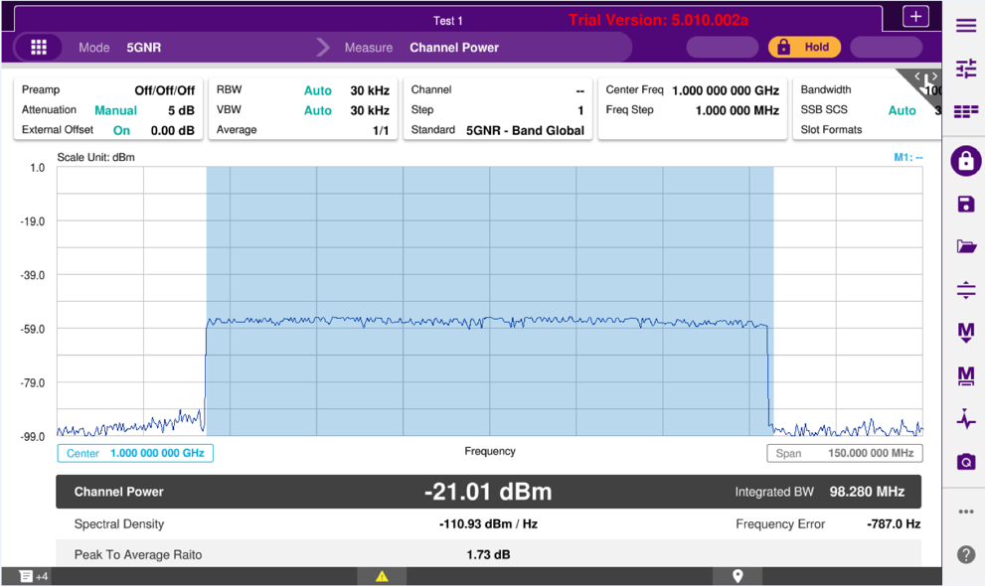
CellAdvisor 5G RF Characterization and Conformance Test
Adjacent Channel Leakage Ratio
5G RF Characterization
Channel Power, Occupied Bandwidth, ACLR
Spurious Emission Mask

Slide 32
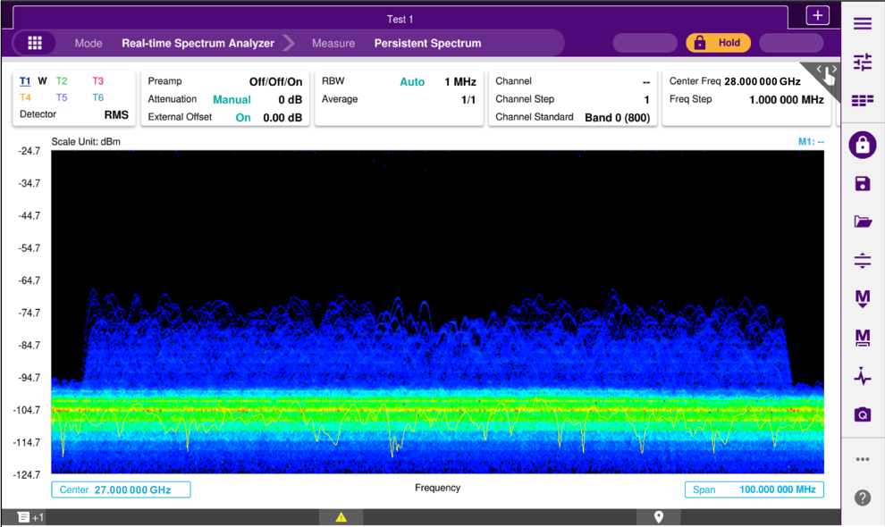
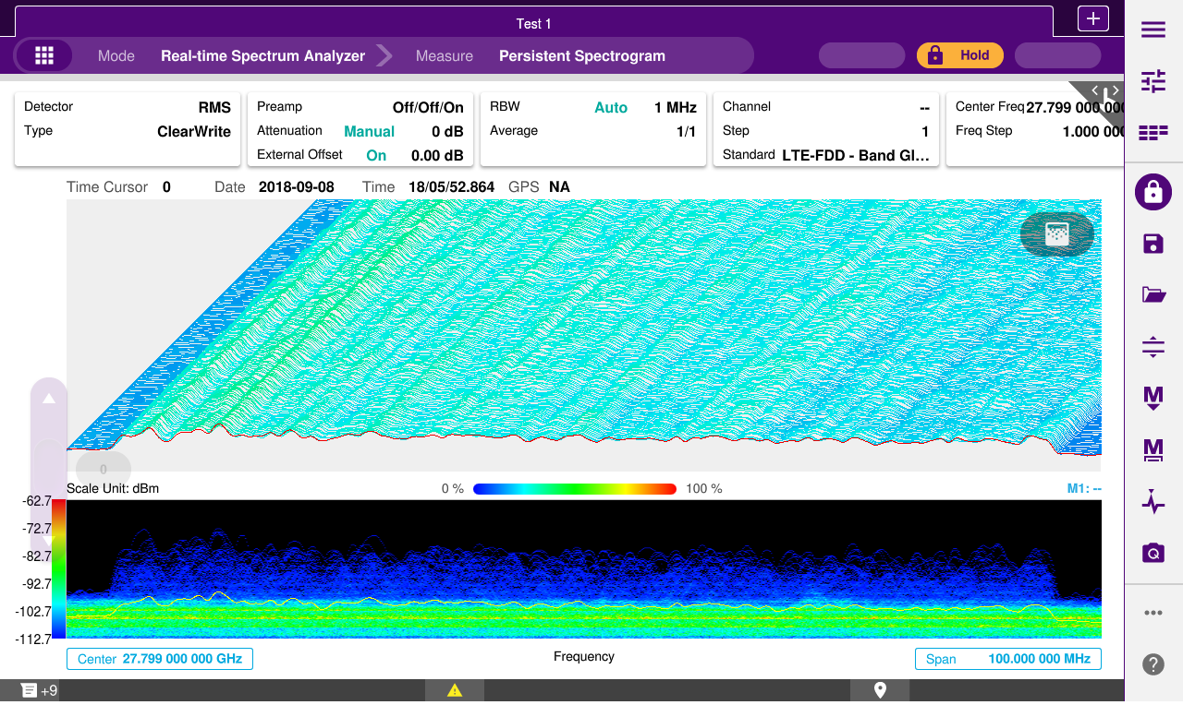
CellAdvisor 5G Persistence Spectrum and Spectrogram
Persistence Real Time Spectrum
Spectrum Analysis, Spectrogram, 3D Spectrogram
Persistence Real Time Spectrogram
Spectrum Analysis, Spectrogram, 3D Spectrogram

Slide 33
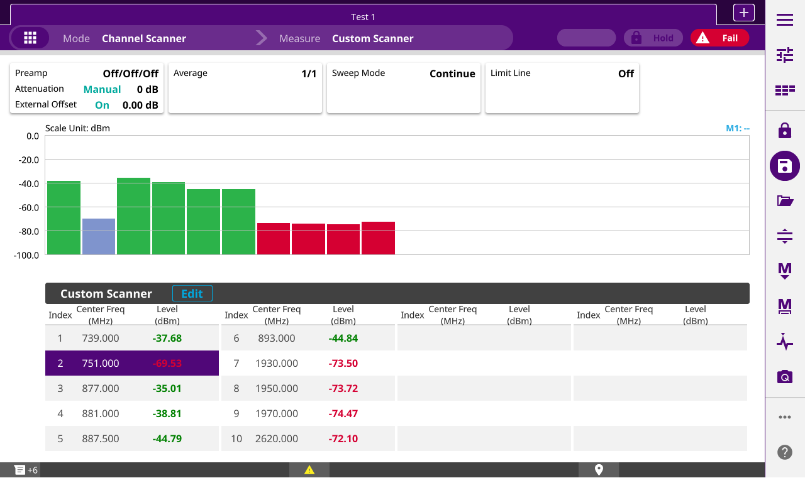
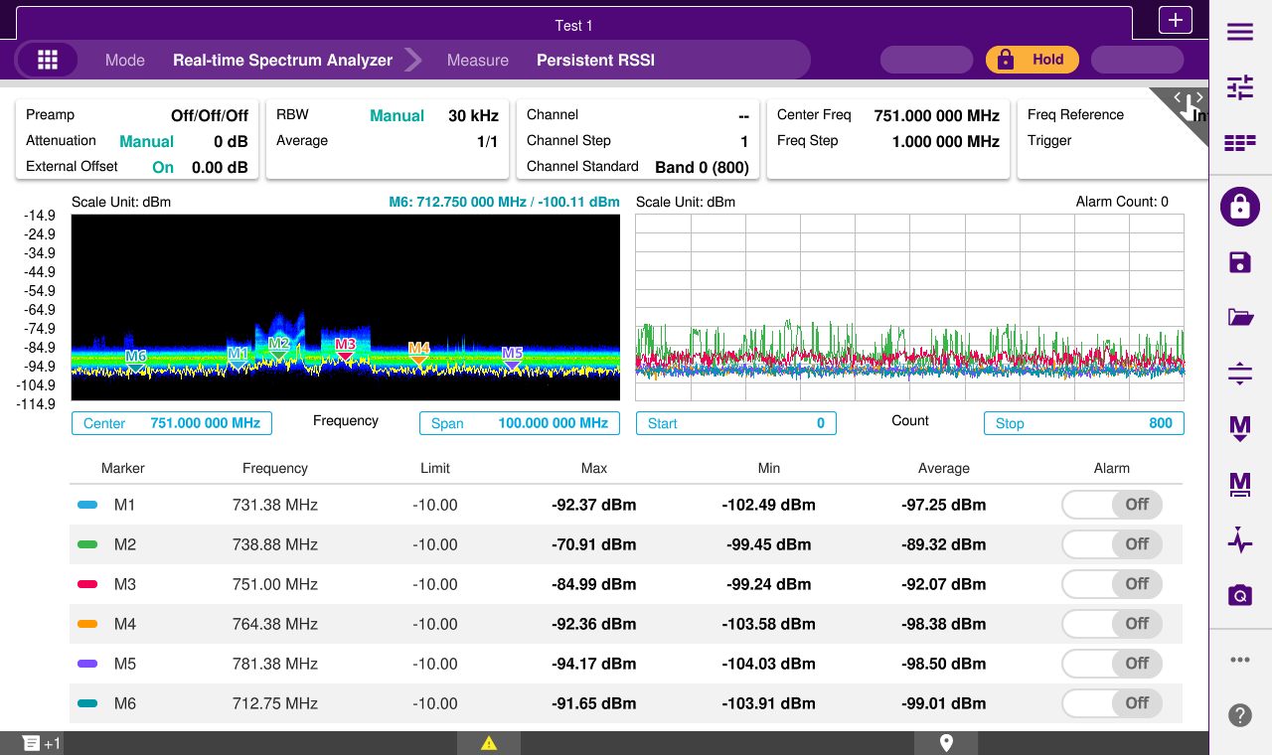
CellAdvisor 5G Channel Scanner and RSSI Power
Channel Scanner
Customizable for Multi-Frequency Band, Multi-Carrier Bandwidth
Multi-Frequency RSSI
Spectrum and RSSI Power Trend

Slide 34
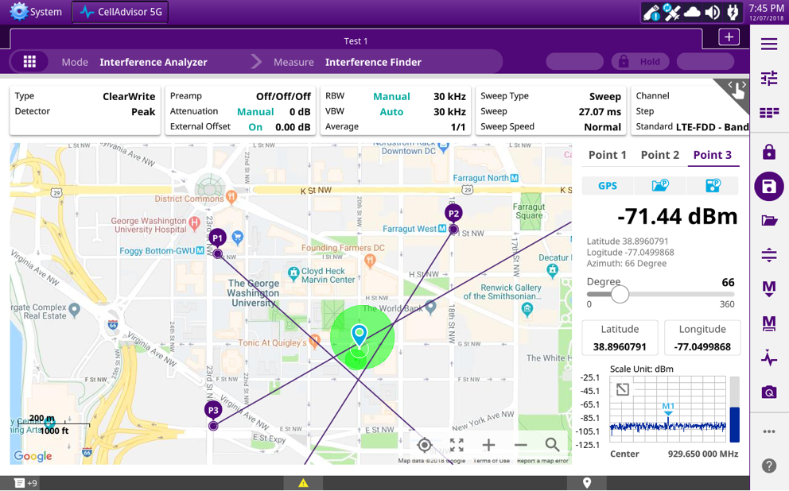
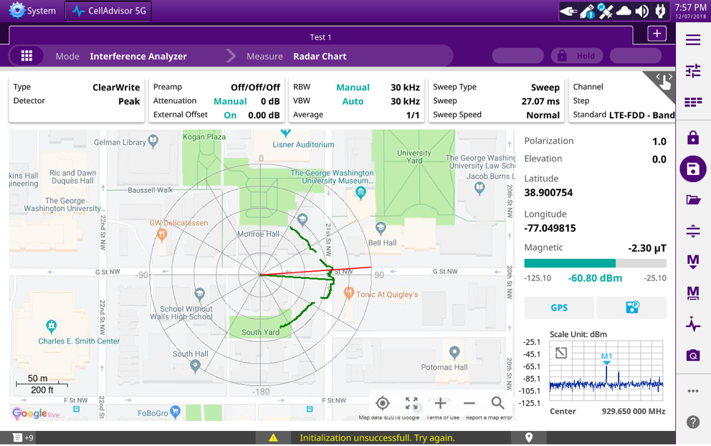
CellAdvisor 5G Interference Analysis: Triangulation and Radar Chart
Interference Finding
Location: Triangulation
Interference Finding
Location: Radar Chart

Slide 35
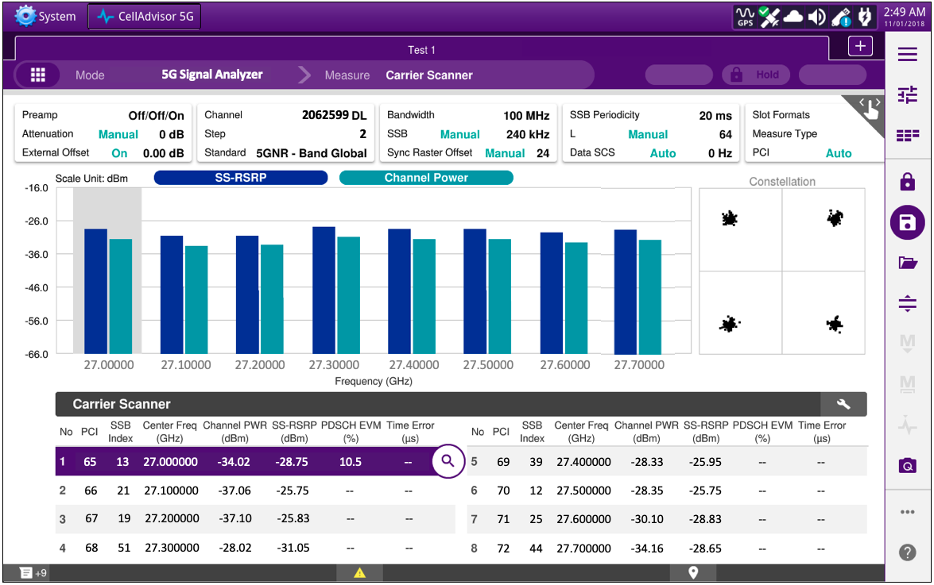
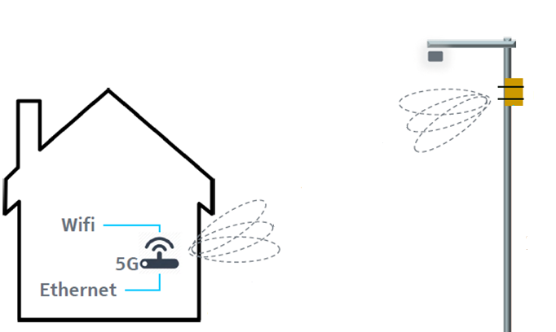
CellAdvisor 5G 5G Carrier Aggregation (x8)
Multi-Carrier Power Balance
Spectral impairments in mmWave
Aggregated 100MHz carriers (x8)
Carrier’s in-band, contiguous and non-contiguous
Radio’s power performance of all carrier’s
PWR
Carrier Aggregation
FREQUENCY
5G Carrier Scanner (8 component carriers)
Physical Cell ID, Beam ID, Carrier’s Frequency and Power, Beam Power and Quality

Slide 36
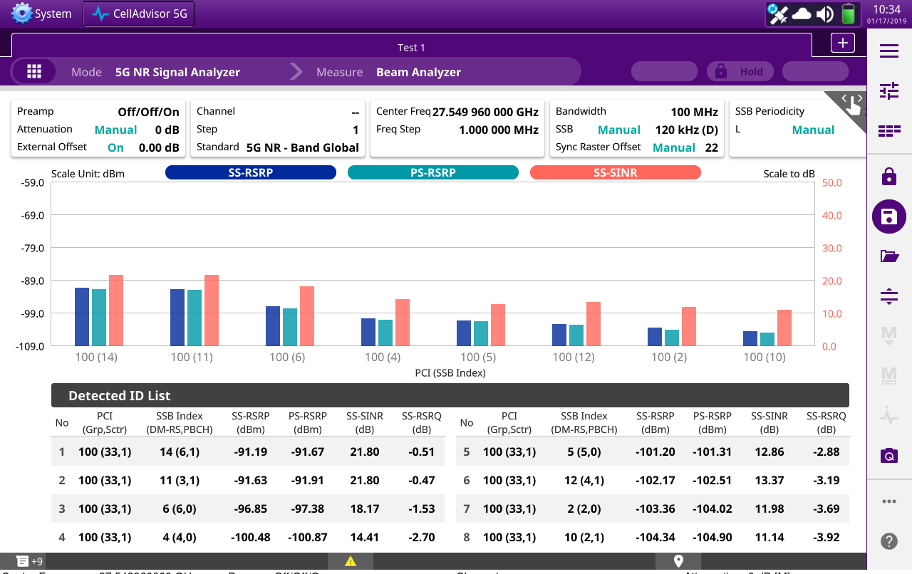
CellAdvisor 5G 5G Beam Analysis
Beamforming Performance
Increase cell capacity (bandwidth)
Increase cell coverage (diversity)
Beam 1
Beam 2
Beam n-1
Beam n
5G Beam Analyzer (8 strongest beams)
Physical Cell ID, Beam Index, Beam Power, P-Sync Power, Beam SNR

Slide 37
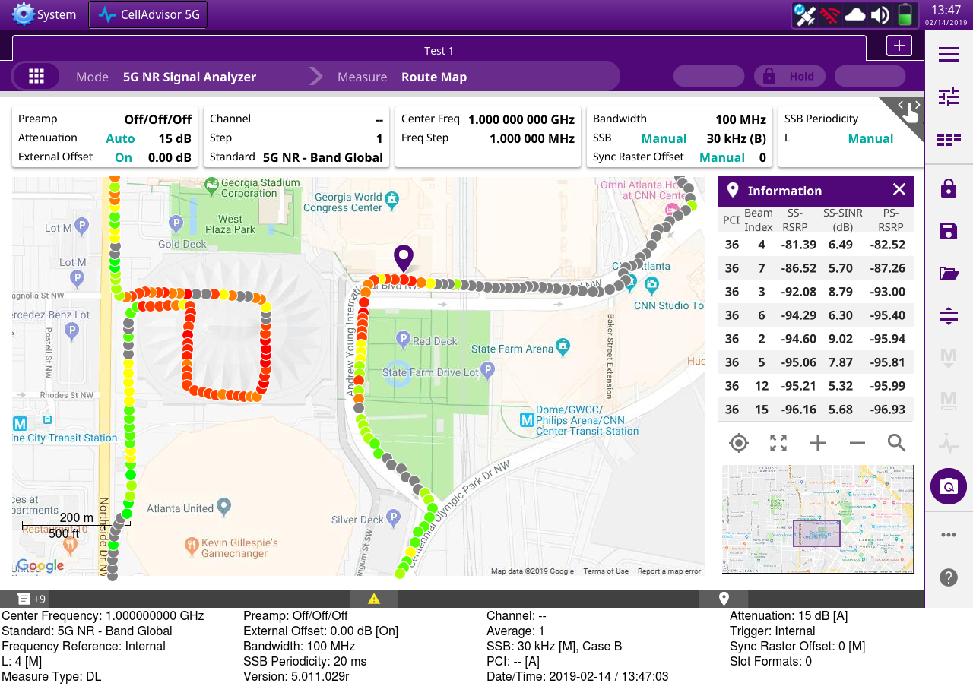
CellAdvisor 5G 5G Route Map Coverage
5G Coverage Mapping
Cell Coverage
Beam Availability
Beam Propagation
5G Route Map (Coverage)
Physical Cell ID, Beam Index, Beam Power, Beam SNR

Slide 38
Questions?

