Slide 1
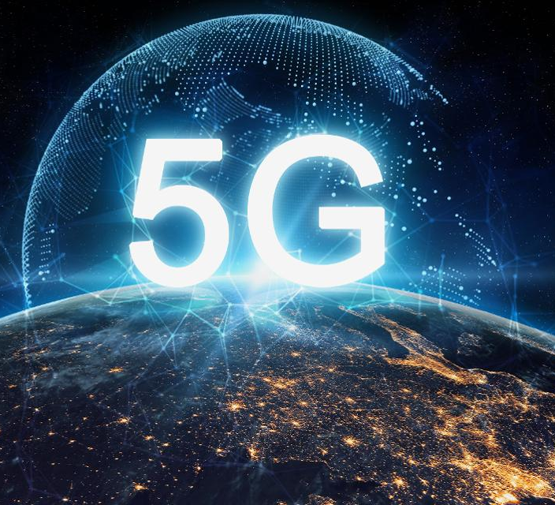
5G RF Safety Awareness
SCTE Safety Tech Session
Penn-Ohio Chapter
February 20, 2020

Slide 2
What is “5G” ???

Slide 3
What is 5G?
5G is the fifth generation of wireless network technology
High speed mobile broadband – Speed up to 10-20 Gigabit per second down-link and 5-10 Gigabit per second up-link (peak data rate)
Low latency services – up to 1 millisecond.
Ultra reliable and scalable network.
Like other cellular networks, 5G networks use a system of cell sites that divide their territory into sectors and send encoded data through radio waves. Each cell site must be connected to a network backbone, whether through a wired or wireless backhaul connection

Slide 4
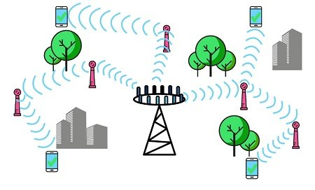
5G - Small cells and Pico-cells
Small cells are low power base stations used in 5G technology to power devices in a small geographical area like few hundred meters up to 2 KM radius. Smalls cells will be using millimeter waves to transmit and receive data. Millimeter waves are not suitable for long distance communication due to higher distortion from atmosphere and obstacles.
Compared to conventional base stations, a large number of small cell units are required to cover a larger area. However, it can provide higher data rate and low latency network coverage for the users under each unit.

Slide 6
RF Hazard
Cellular antennas use radio waves to transmit signals.
Radio waves are a form of electromagnetic energy and are referred to as "radio frequency" or "RF" energy or radiation
Prolonged exposure to RF energy can increase a person’s body temperature (by causing the atoms in your body vibrate faster)
Tissue damage may occur because of the body's limited ability to dissipate excessive heat
RF exposure effects are not cumulative
Multiple exposures do not add up…when exposure stops, any heating is dissipated
At low levels of exposure or short exposure times, where significant buildup of heat does not cause damage to tissues, temporary heating of tissues will not cause lasting effects.

Slide 7
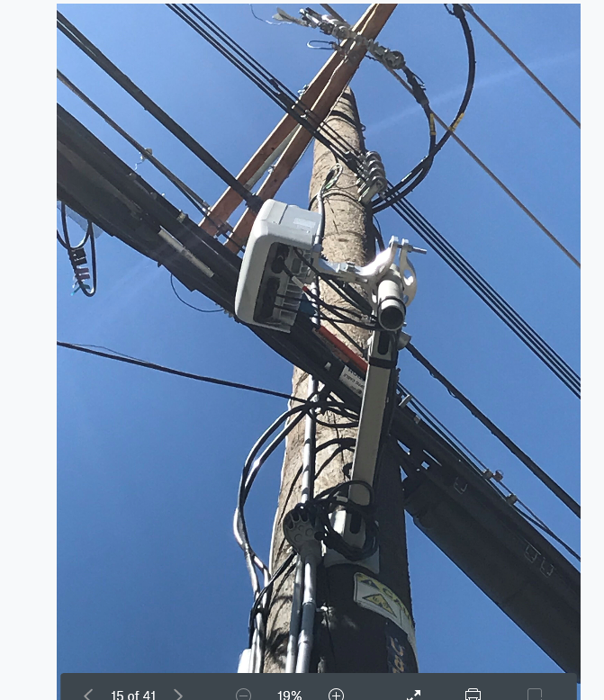
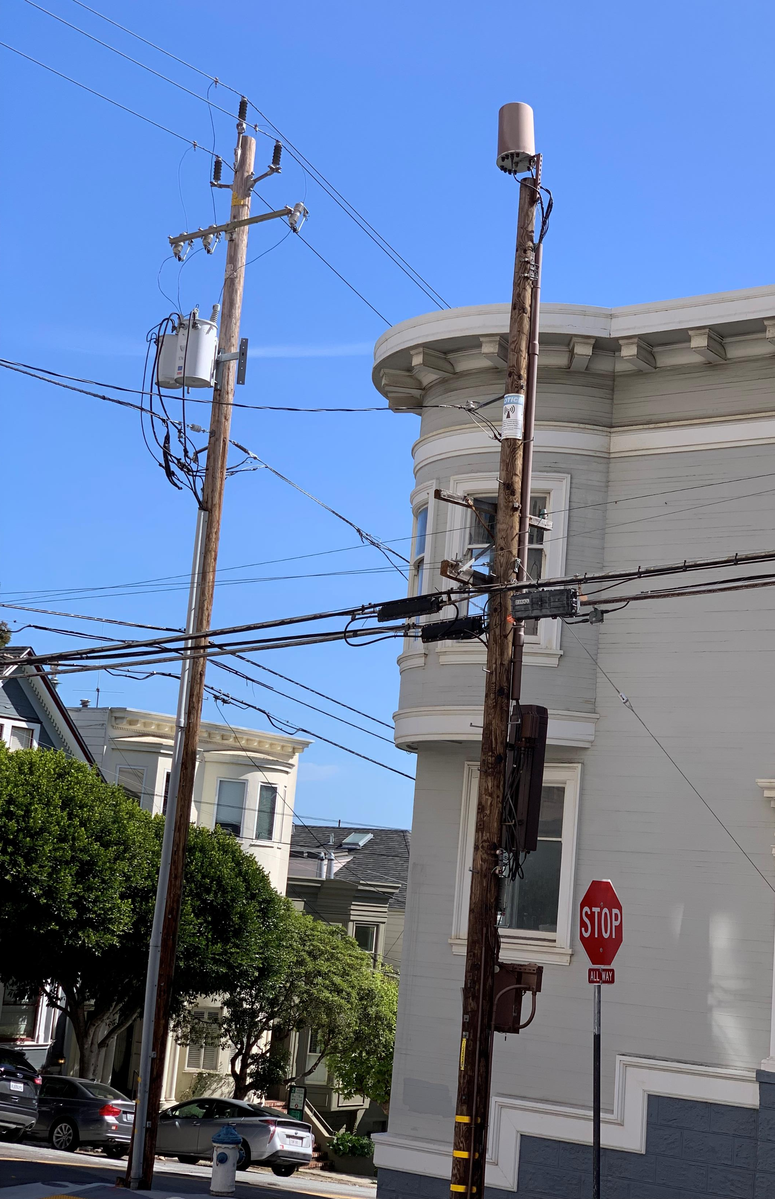
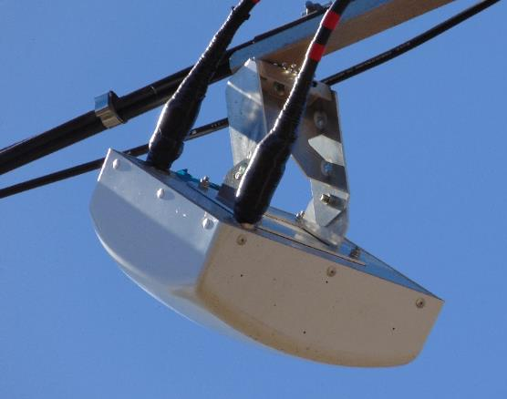
5G Network Status
5G network is being built out, but largely not yet energized
Higher frequency signal leads to poor coverage and need for higher antenna density
Can be mounted on strand, pole, top of pole, etc.
May be near or above our plant, and near our active devices
Safety implications (if any) are still unclear for employees working near one of these devices

Slide 8
Primary Concerns
Higher frequency; more susceptible to interference; need for higher density of antennas
Currently not powered up due to small number of available handsets
Work around devices
24hr SLA causing friction in business
RF meter cost and deployment
LOTO options

Slide 9
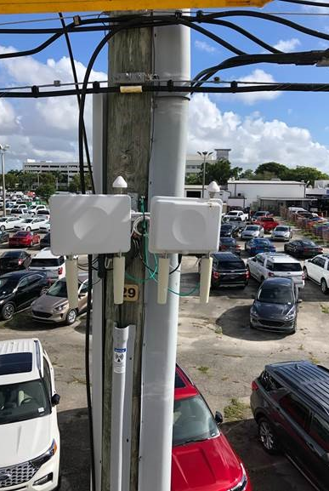
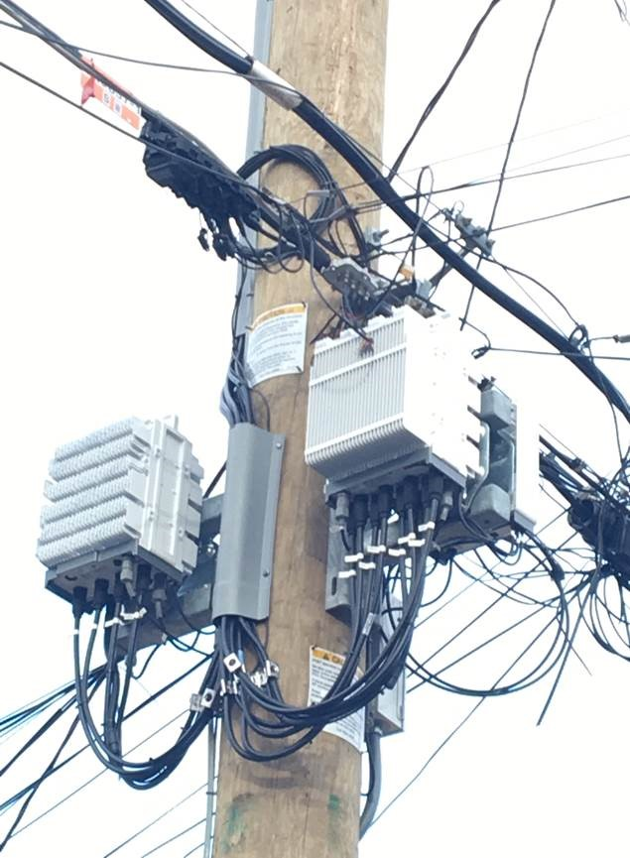
What we’re seeing…

Slide 10
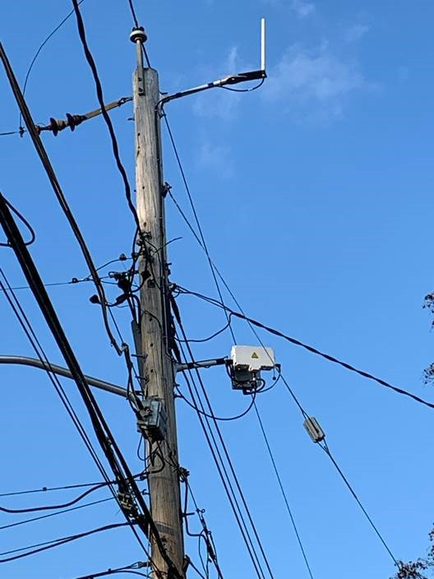

Slide 11
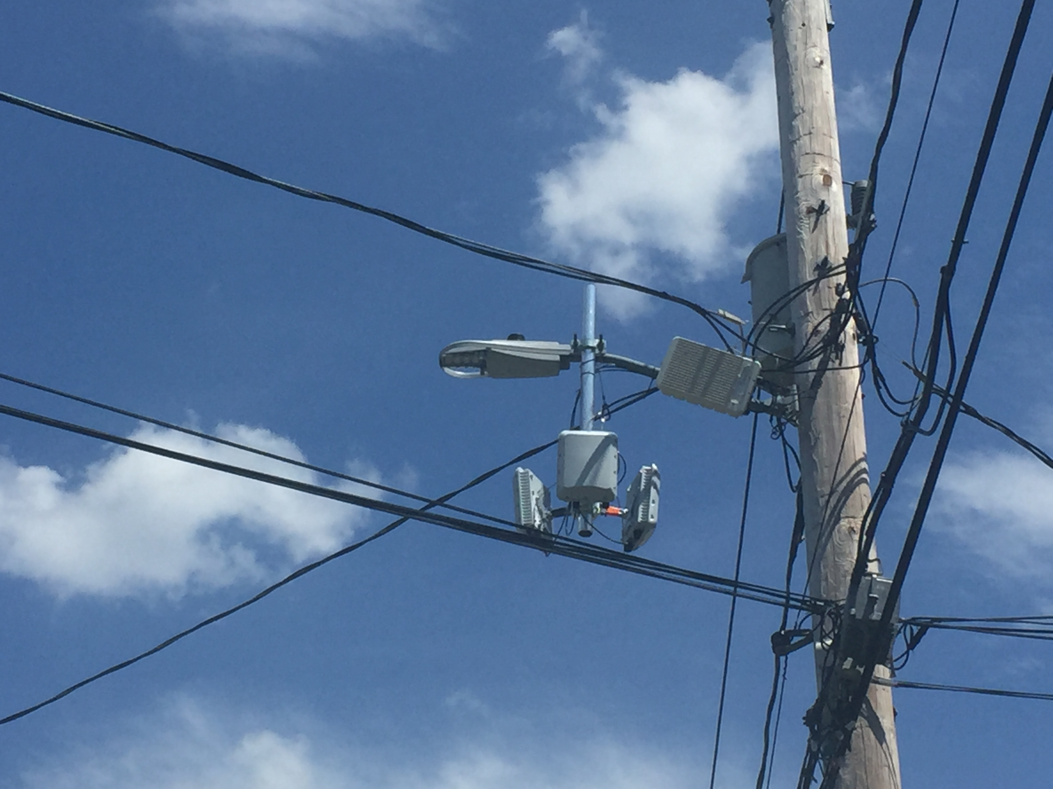

Slide 12
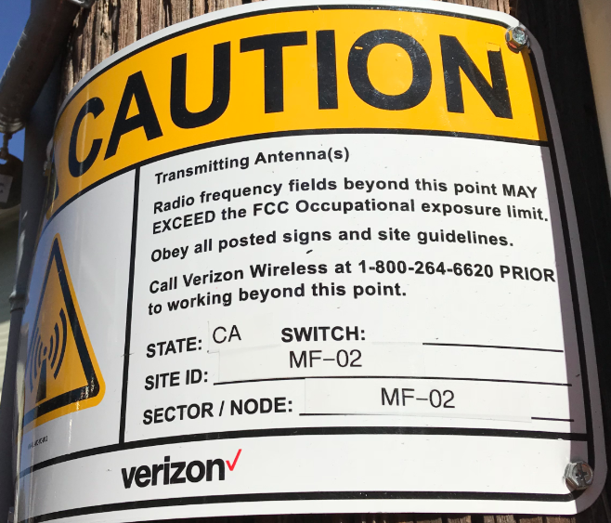
Warning Signage

Slide 13
RF Warning Signage
Notice: Beyond this point, the non-ionizing Radiofrequency (RF) exposure may exceed the general population limit.
Caution: Beyond this point, the non-ionizing Radiofrequency (RF) exposure may exceed the occupational limit for trained workers.
Warning: Beyond this point, the non-ionizing Radiofrequency (RF) exposure may exceed ten times (10x) the occupational limit for trained workers. Any exposure, even for trained workers, must be very limited.
Danger: Beyond this point, any non-ionizing Radiofrequency (RF) exposure is a health risk and may cause contact current or RF burns.

Slide 14
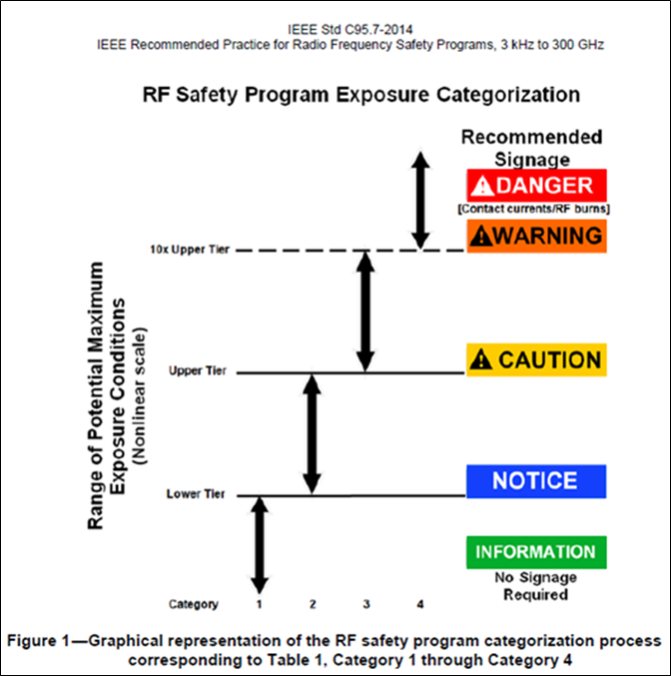
Danger: Beyond this point, any non-ionizing Radiofrequency (RF) exposure is a health risk and may cause contact current or RF burns.
Warning: Beyond this point, the non-ionizing Radiofrequency (RF) exposure may exceed ten times (10x) the occupational limit for trained workers. Any exposure, even for trained workers, must be very limited.
Caution: Beyond this point, the non-ionizing Radiofrequency (RF) exposure may exceed the occupational limit for trained workers.
Notice: Beyond this point, the non-ionizing Radiofrequency (RF) exposure may exceed the general population limit.
Information: No signage required

Slide 15
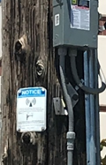
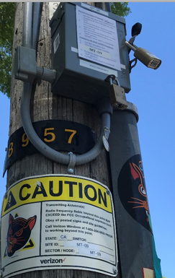
Energy Control
5G Potential for LOTO
Backup battery a concern
Regulatory issues
Locks
Procedures
Locking out someone else’s equipment
Training
Try-out
Etc

Slide 16
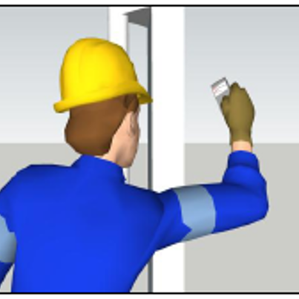
Possible Alternative to Lock-out/Tag-out….. The Use of Personal RF Monitors
Usually no local power switch to lock-out.
Prior to entry, RF monitor verifies antenna is off.
Worker warned if antenna is turned on.
Unlike electrocution, worker is not instantly harmed.
Can still be below RF standard due to 6-minute time-weighted-average limit.

Slide 17
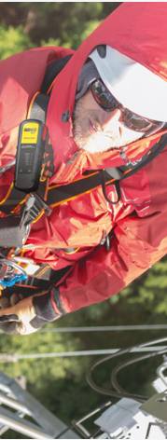
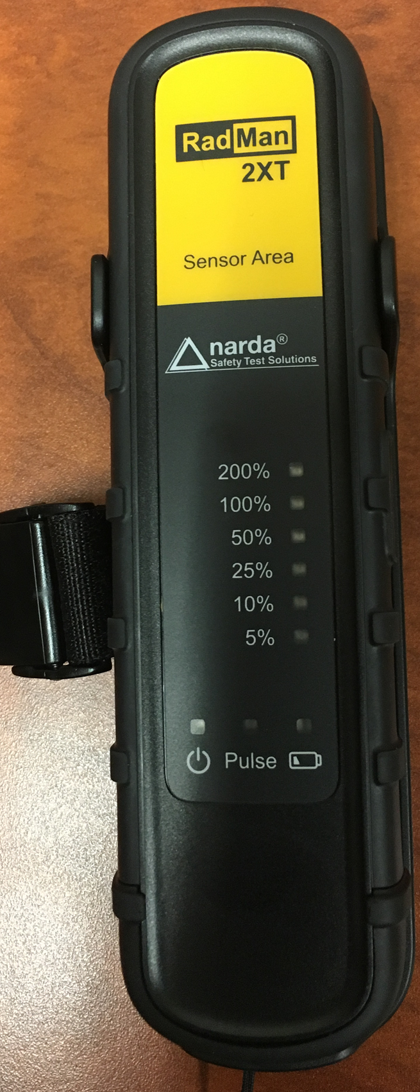
Narda Radman XT

Slide 18
Narda RadMan 2XT Personal RF Monitor
RadMan RF monitors can be hand-held or attached to the harness near the shoulder. They operate similarly to a Foreign Voltage Detector (FVD).
The device is rechargeable with a USB cable, and needs calibration every three years.
The only control is the on/off button on the side of the monitor.
Once turned on, it will take about 15-20 seconds for the RF monitor to self-calibrate and test the alarms and indicator LEDs.
The alarm set points have been preset by the manufacturer.
The LED lights, audible alarm, and vibration will indicate the RF exposure level is beyond 50% of the occupational limit (first alarm level), and 100% of the occupational limit (second alarm level).
The LED lights indicate RF levels from 5% - 200% of the occupational standard.
The sensor area is marked in yellow and must always face toward the antenna to obtain an accurate reading.

Slide 19
What is considered a safe distance from a 5G antenna? (1)
The safe distance depends on two factors:
The orientation of the antenna (e.g., directional or omnidirectional)
The power level of the antenna.
Keep in mind that many antennas can have variable power, increasing during peak usage periods and decreasing when there is less mobile phone traffic.

Slide 20
What is considered a safe distance from a 5G antenna? (2)
Generally, for directional antennas (e.g., flat surface) the safe distance from frontal surface is greater than above, below, behind, or to the side the antenna.
Some antennas are omni-directional (e.g., cylinder-shaped) and the Radiofrequency (RF) waves are transmitted 360 degrees laterally.
The unsafe RF distance from the antenna also depends on the wattage of the unit, and the percent demand on the system.
At full power, the unsafe RF distance may be between 6-16 feet from the antenna, depending on the model.

Slide 21
What is considered a safe distance from a 5G antenna? (3)
As of Q1 2020, there are very few 5G handsets, which means the antennas are typically operating at minimum power.
During field testing, the safe RF distances measured were in the area further than approximately one foot from the surface of the antennas.
Since there is no way to determine by looking at the antenna what power it is operating, one must always assume that they are operating at full power.
Therefore, never assume any safe distance to work from an antenna unless it has been validated by an RF monitor.

Slide 22
What exposure levels may be considered safe?
The General Public Exposure Limit, which is a Radiofrequency (RF) level of 1 mW/cm² or less, applies to all technicians that have not completed the RF Safety Training module.
A technician is classified as a “trained worker” around 5G antennas and can work in areas at up to 50% of the Occupational Exposure Limit or 2.5 mW/cm² only after they have completed RF safety training, and one or both of the following conditions exists:
They have an RF monitor to warn them of unsafe RF exposure levels,
and/or
A representative from the wireless carrier has shut off the transmitter and verified this in person at the antenna site.
In summary, technicians must go through training, and may not go past the posted signs unless:
1) the carrier has shut off the antenna and this is verified by a representative from the carrier on site,
and/or
2) the power levels are confirmed safe by a tech ops supervisor (or higher), technician or Safety Professional using an approved RF monitor.

