Slide 1
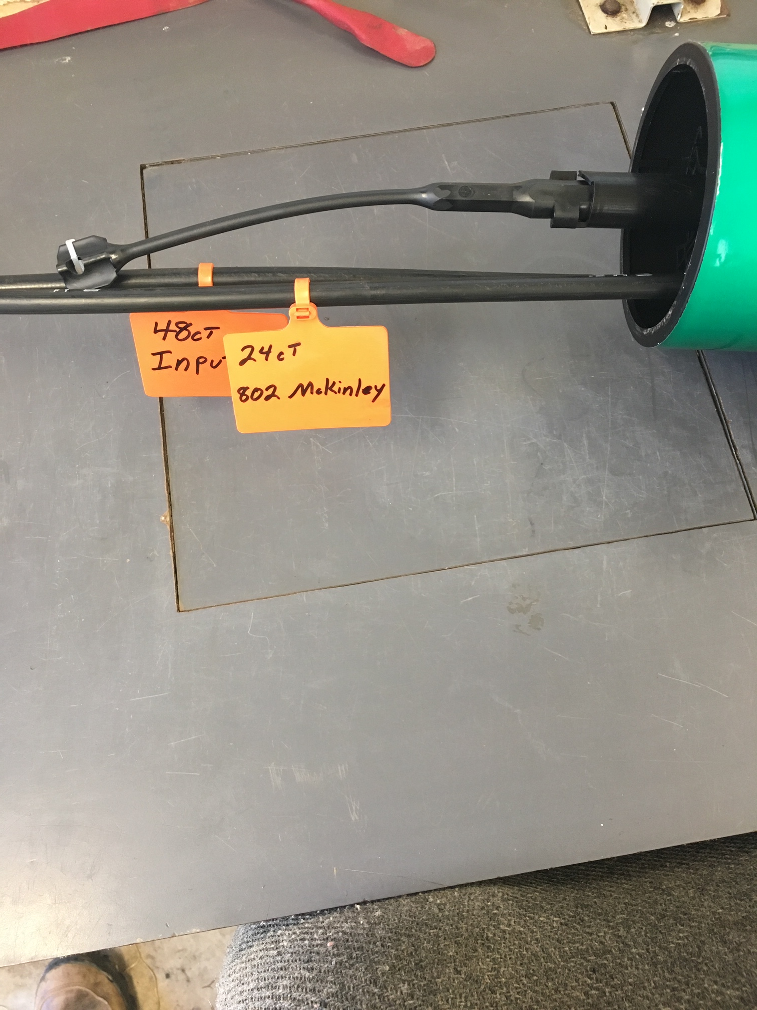
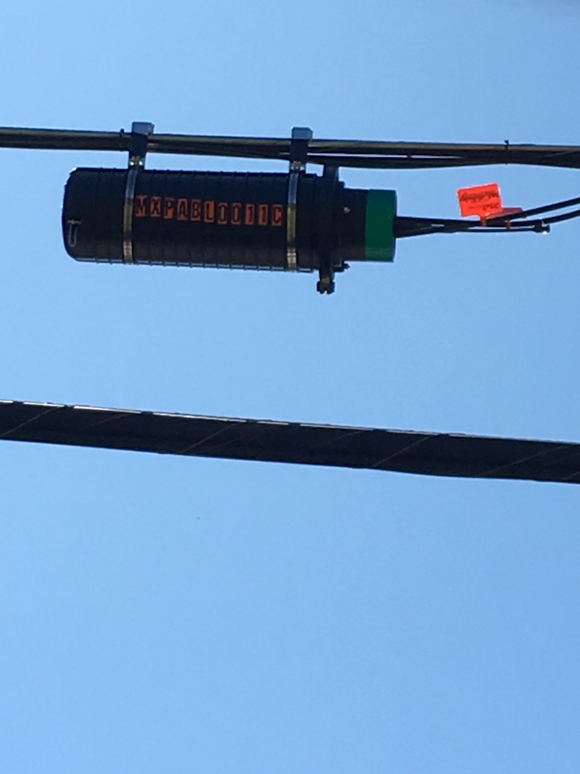
A Metro-E MUX looks exactly like a normal Tyco B Splice Enclosure but will have green tape on the end

Slide 2
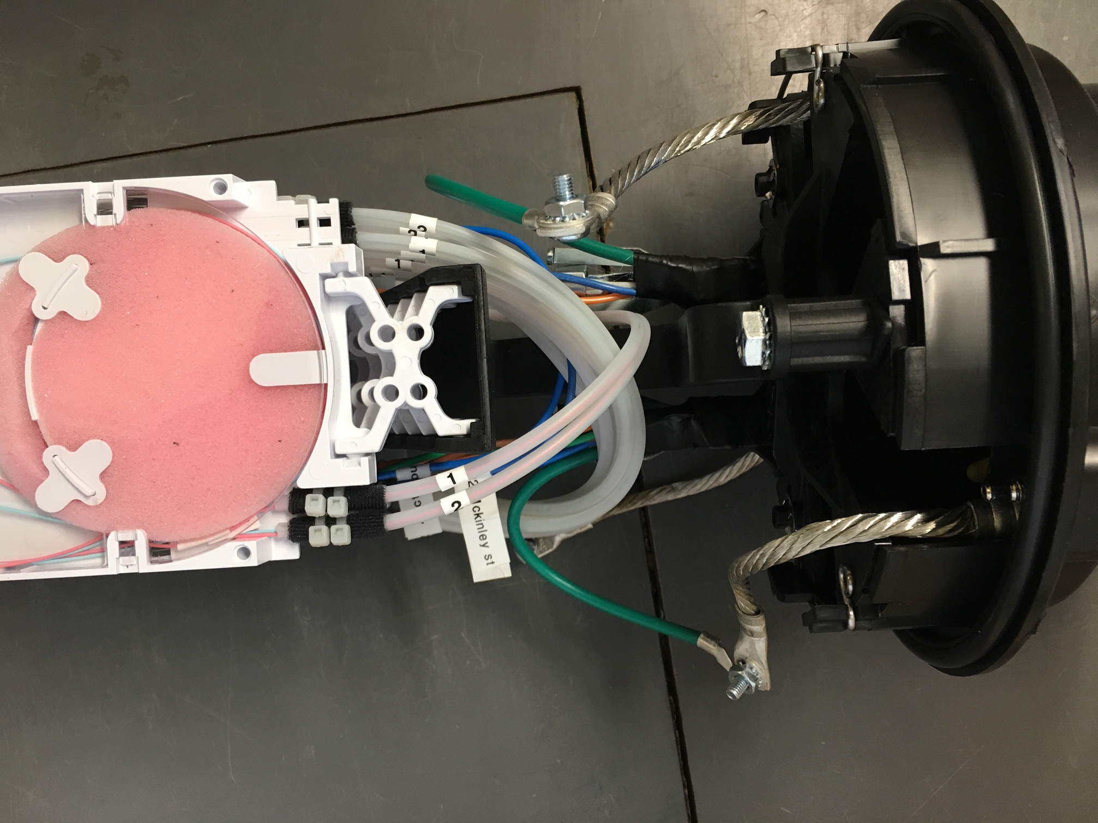

Slide 3
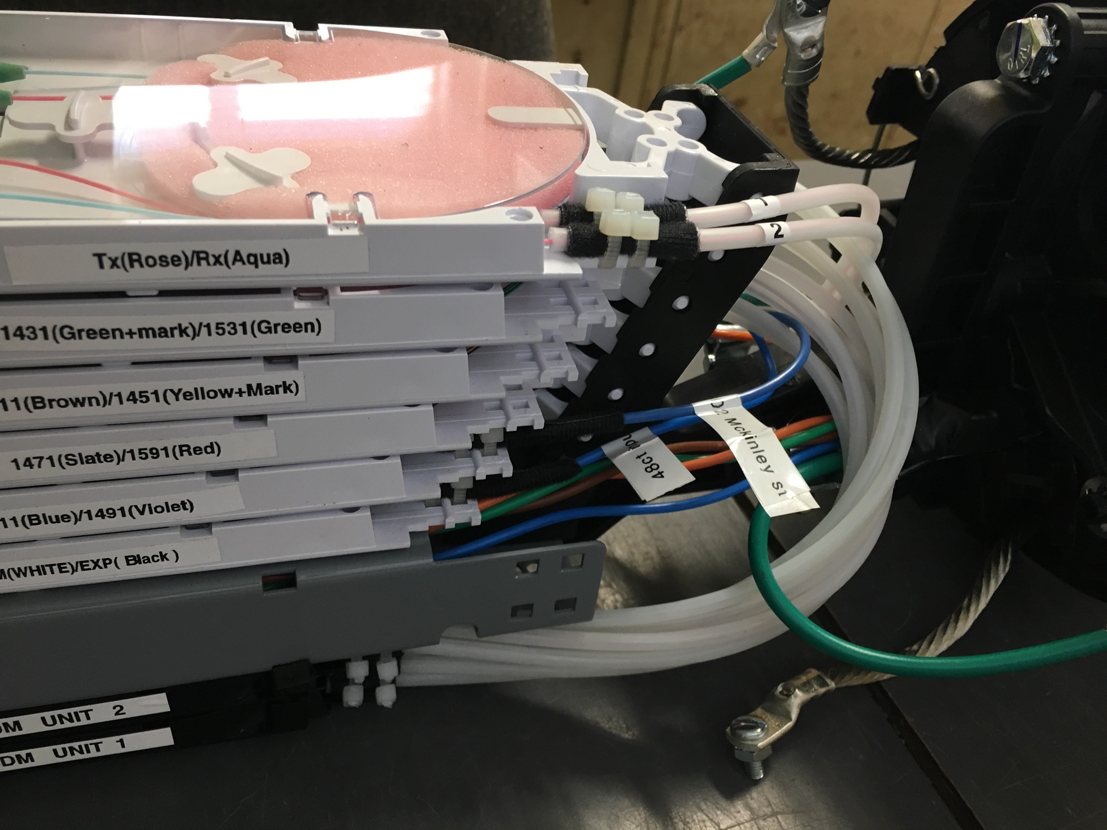

Slide 4
Frequencies

Slide 5
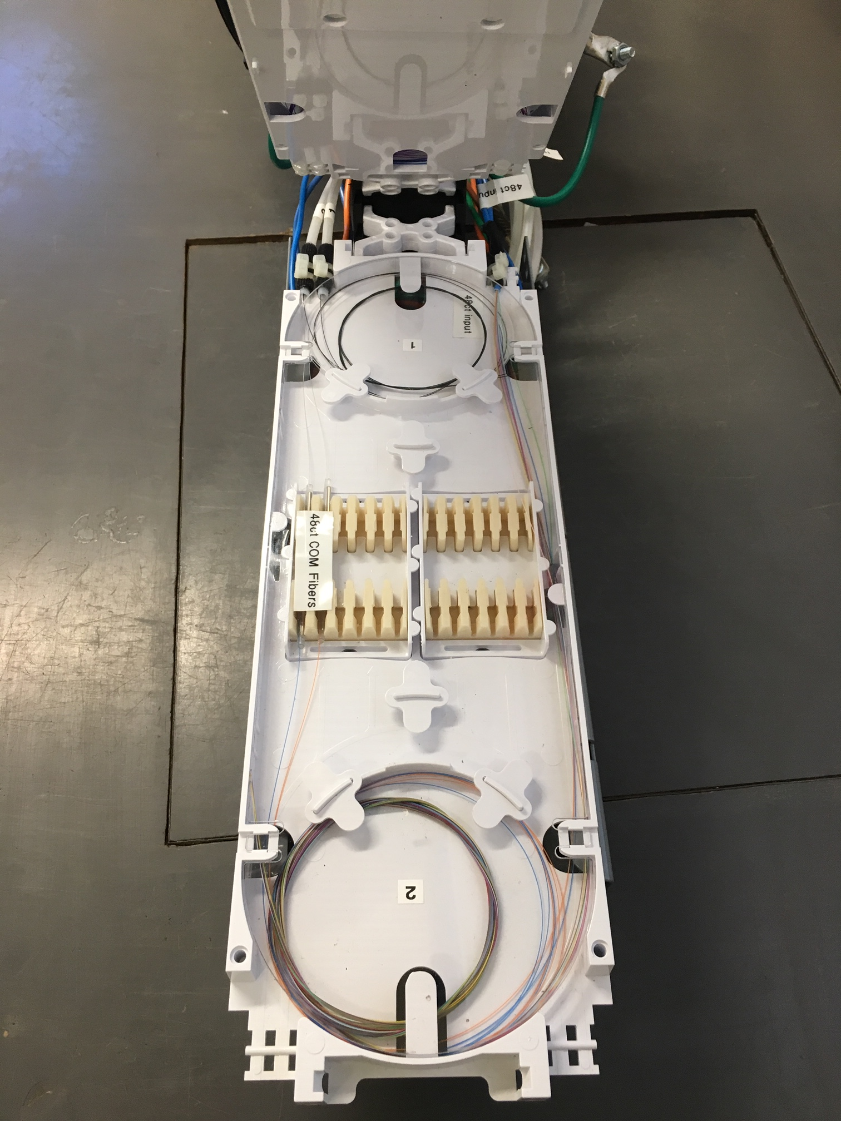
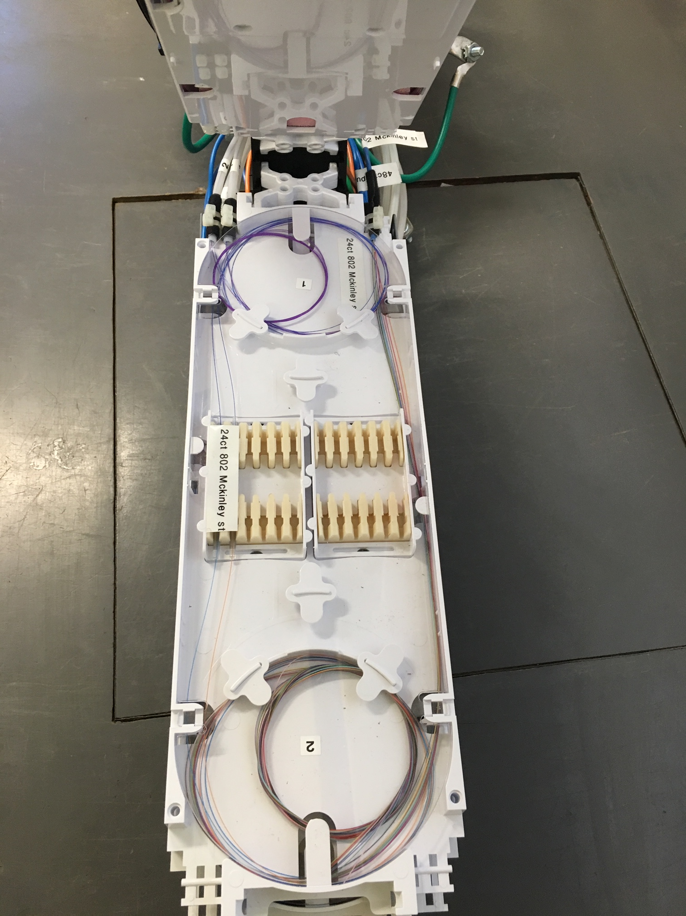
Common Fibers:
These are the fibers coming from the headend that power up the MUX
Customer Fiber:
These are the fibers leaving the MUX on a designated frequency and feed the customer. This customer is on 1511

Slide 6
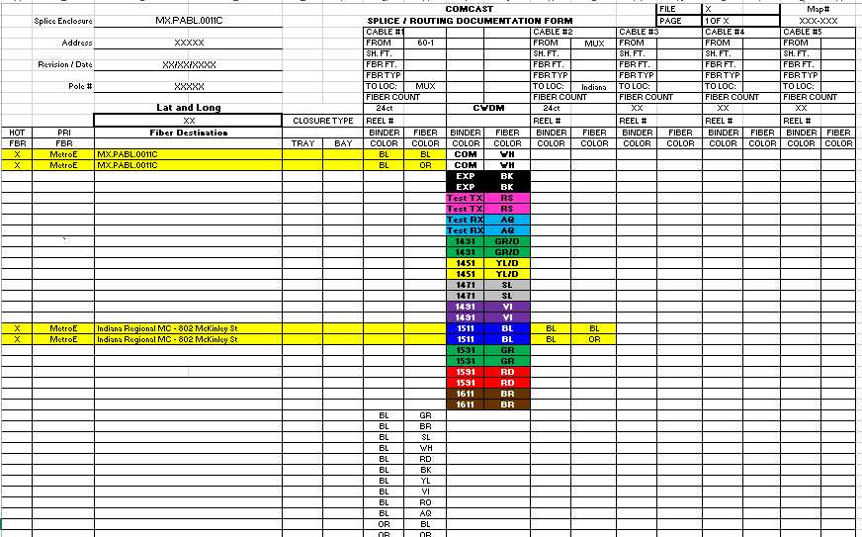
MUX Splice Documents

Slide 7
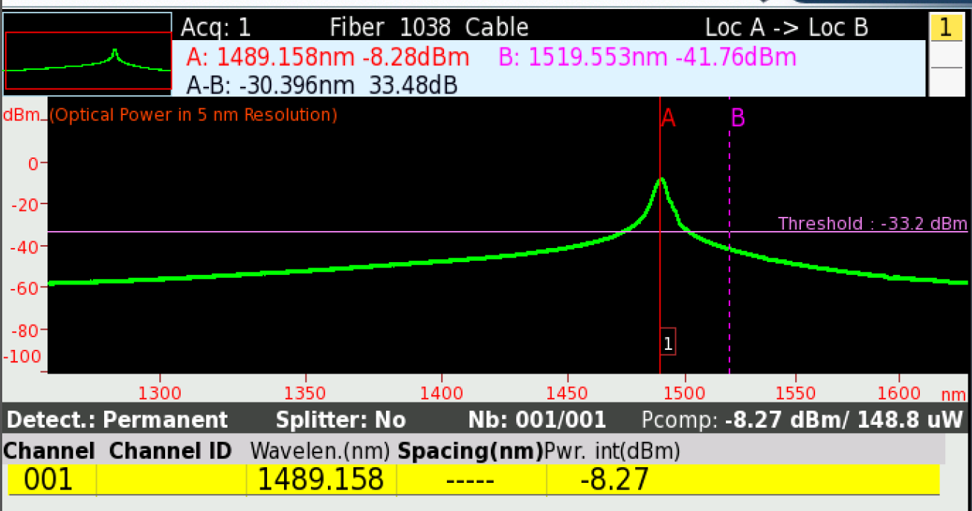
Divide this number in two to find your loss through the loop jumper -4.14

Slide 8
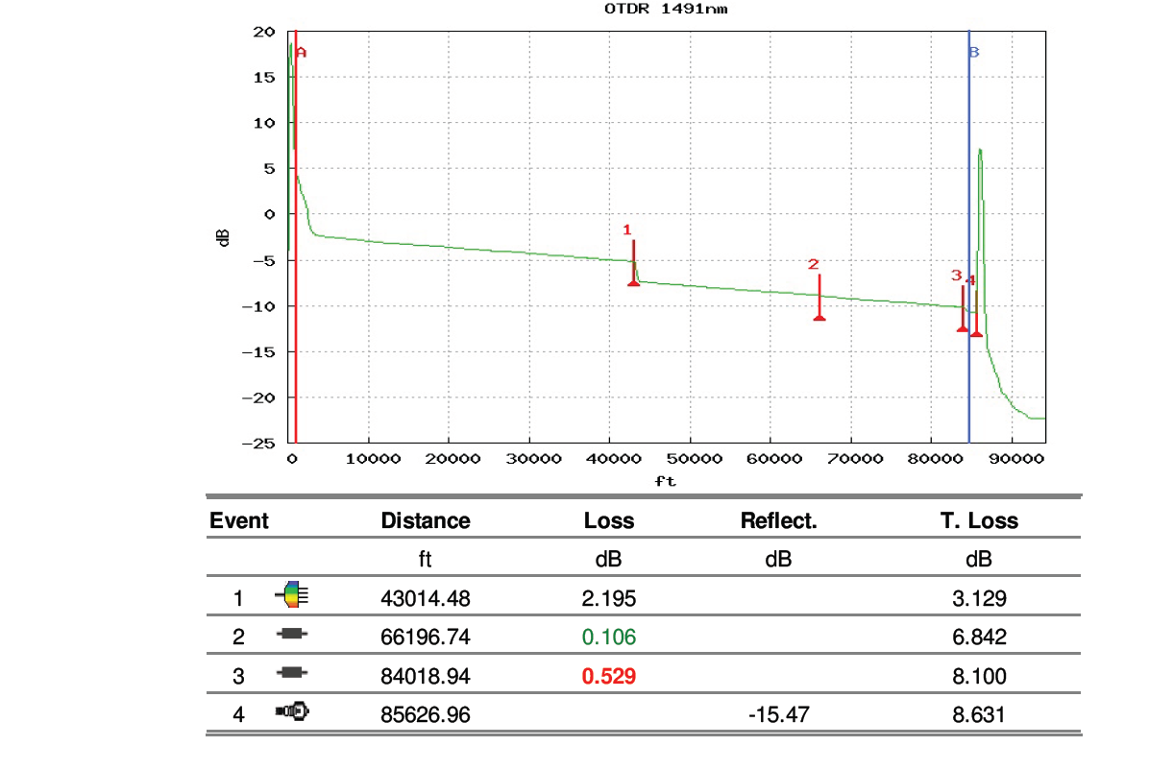
OTDR Trace With Loop Jumper

